Slide 1
Survey Comparison Project Figures

Slide 2
SVC vs. Roving Surveys

Slide 3
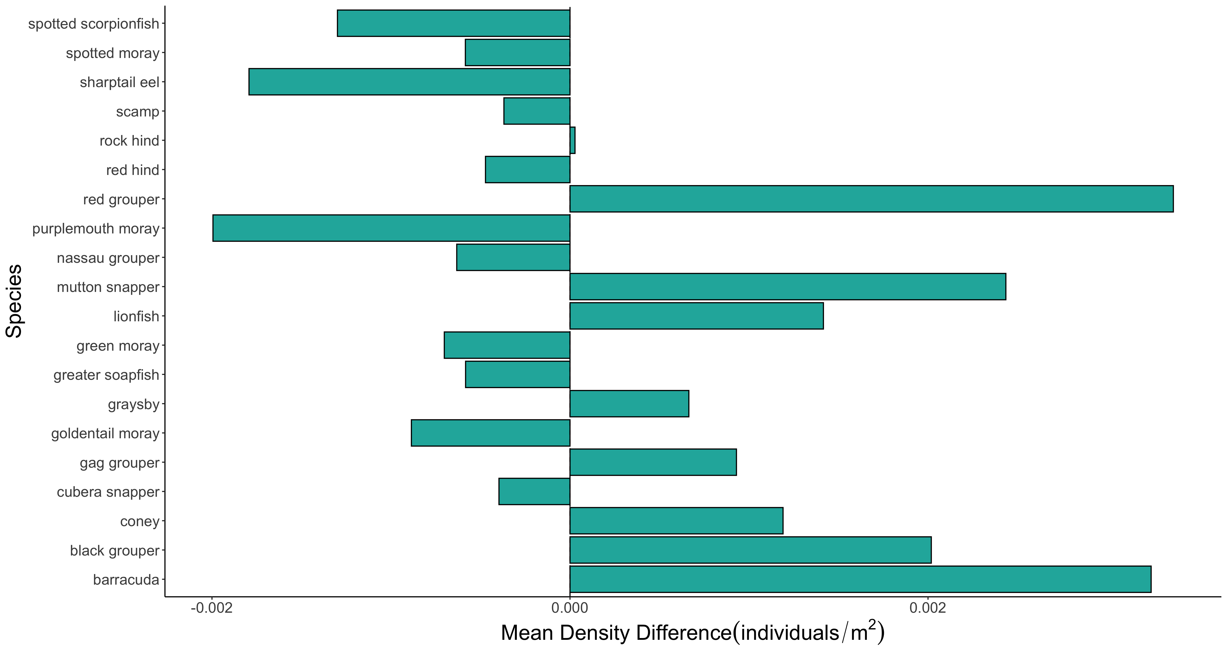

Slide 4
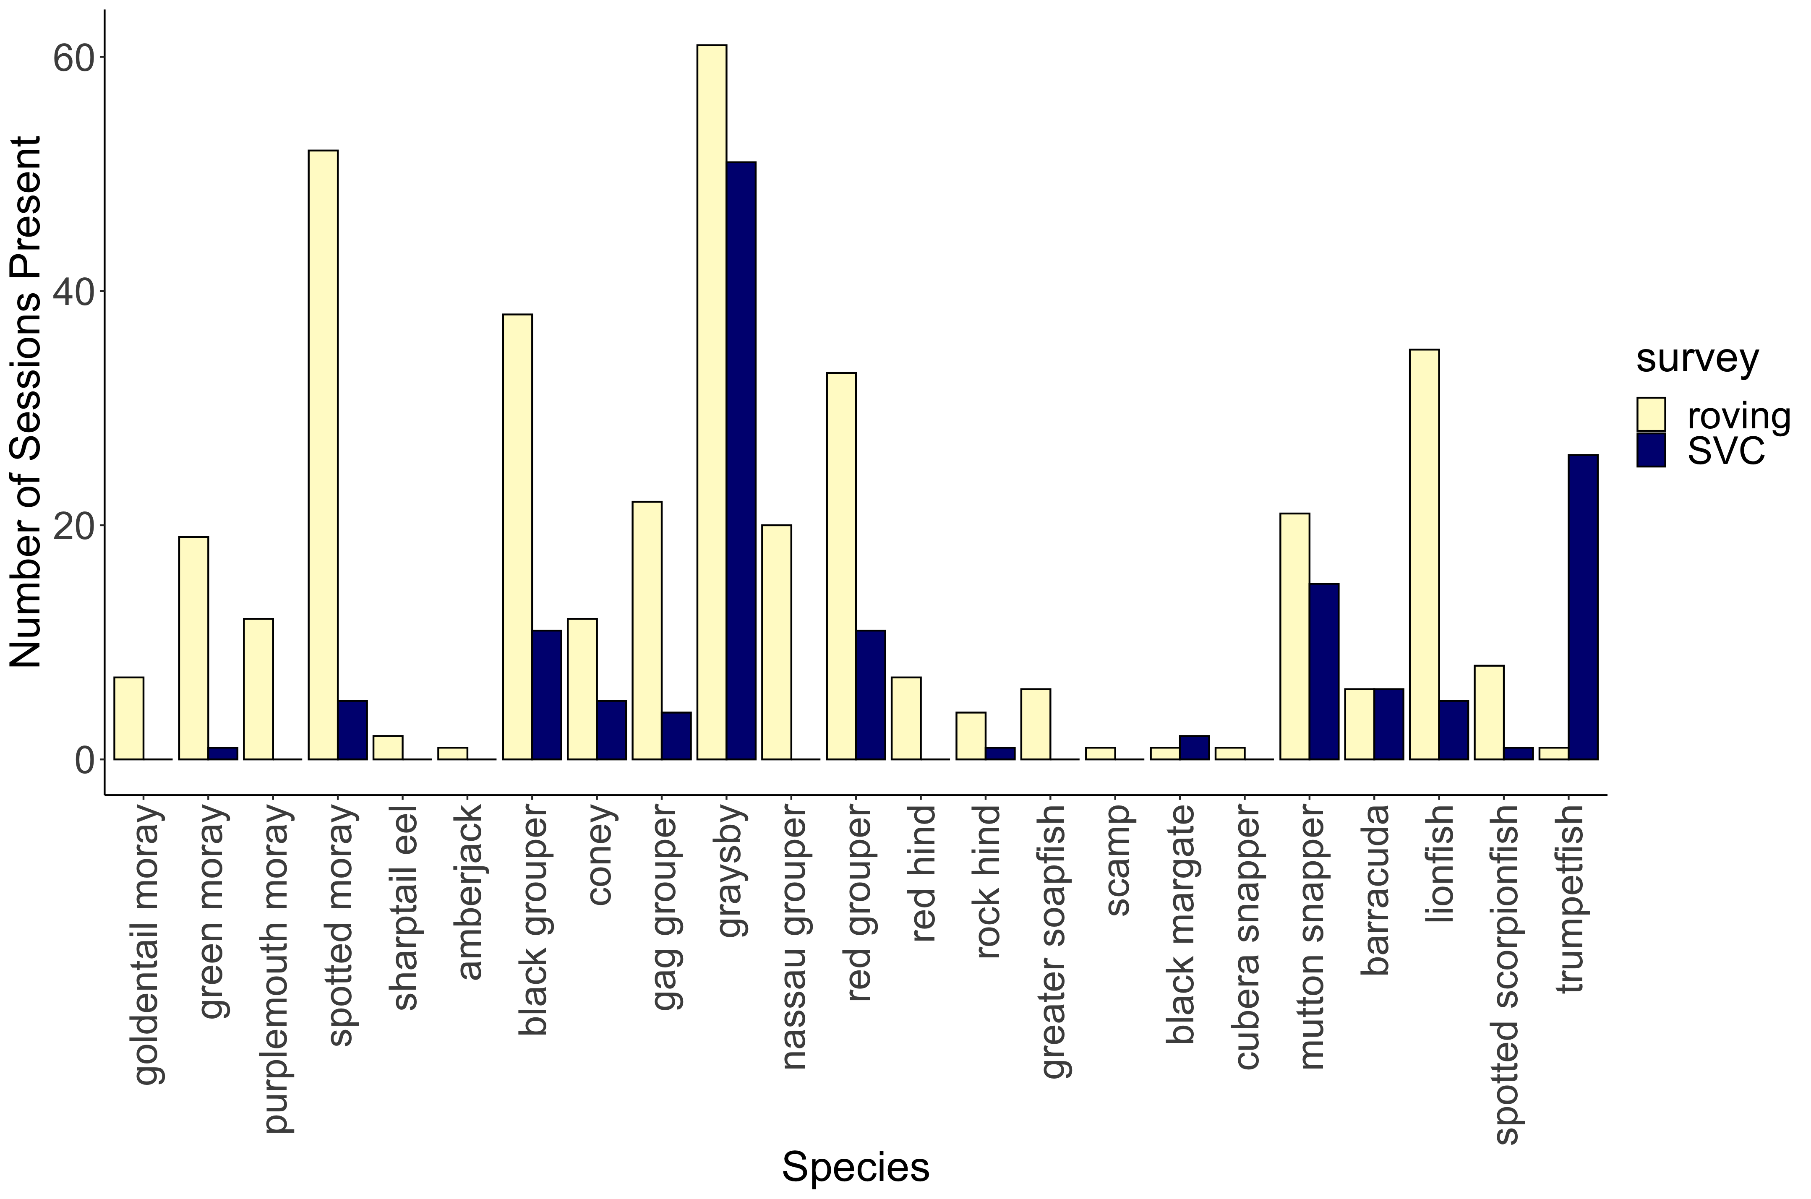
***
***
***
***
***
***
***
***
**
*
*
*
*

Slide 5
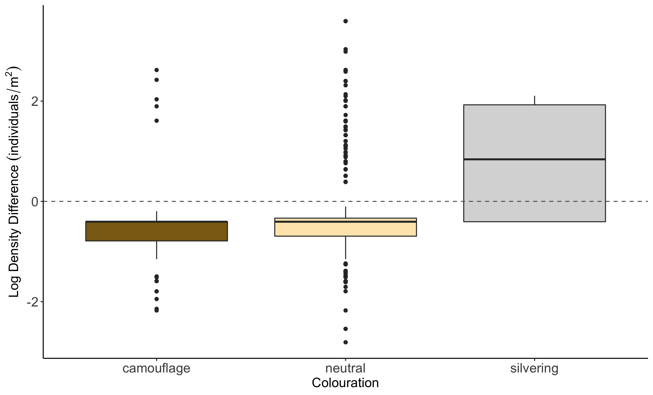
b
a
c

Slide 6
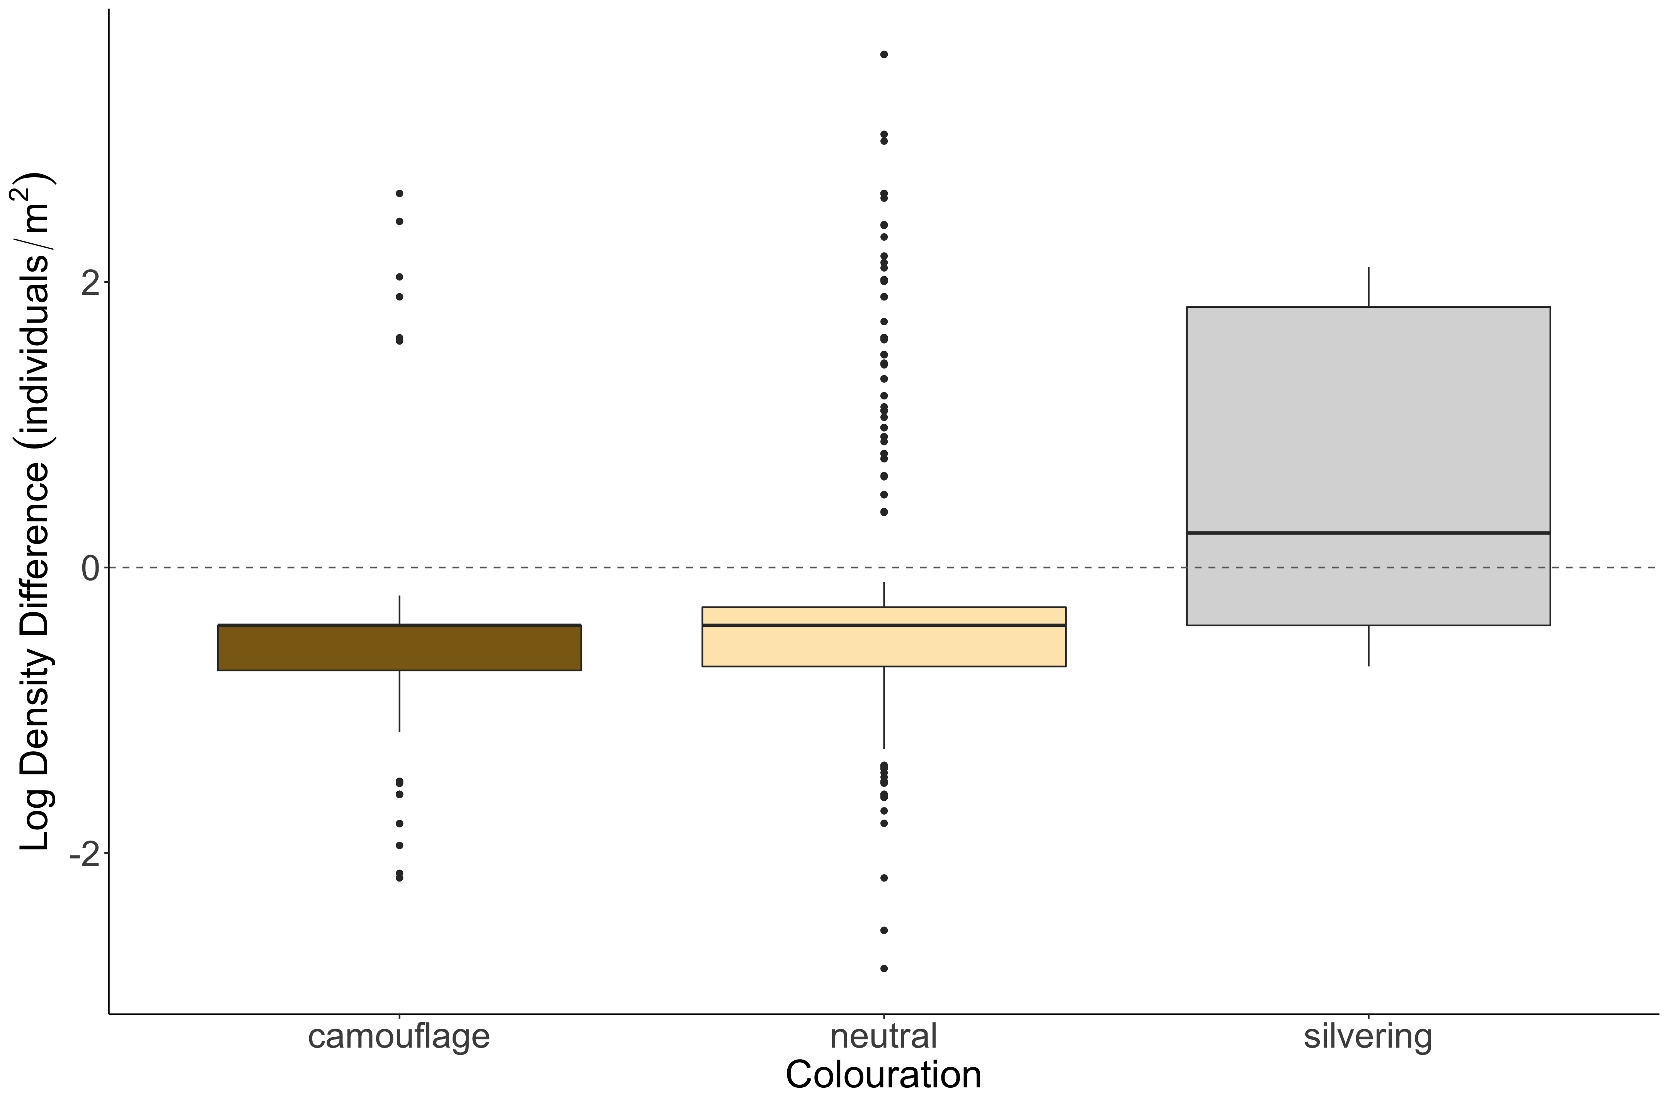
b
a
c

Slide 7
SVC vs. Transect Figures

Slide 8
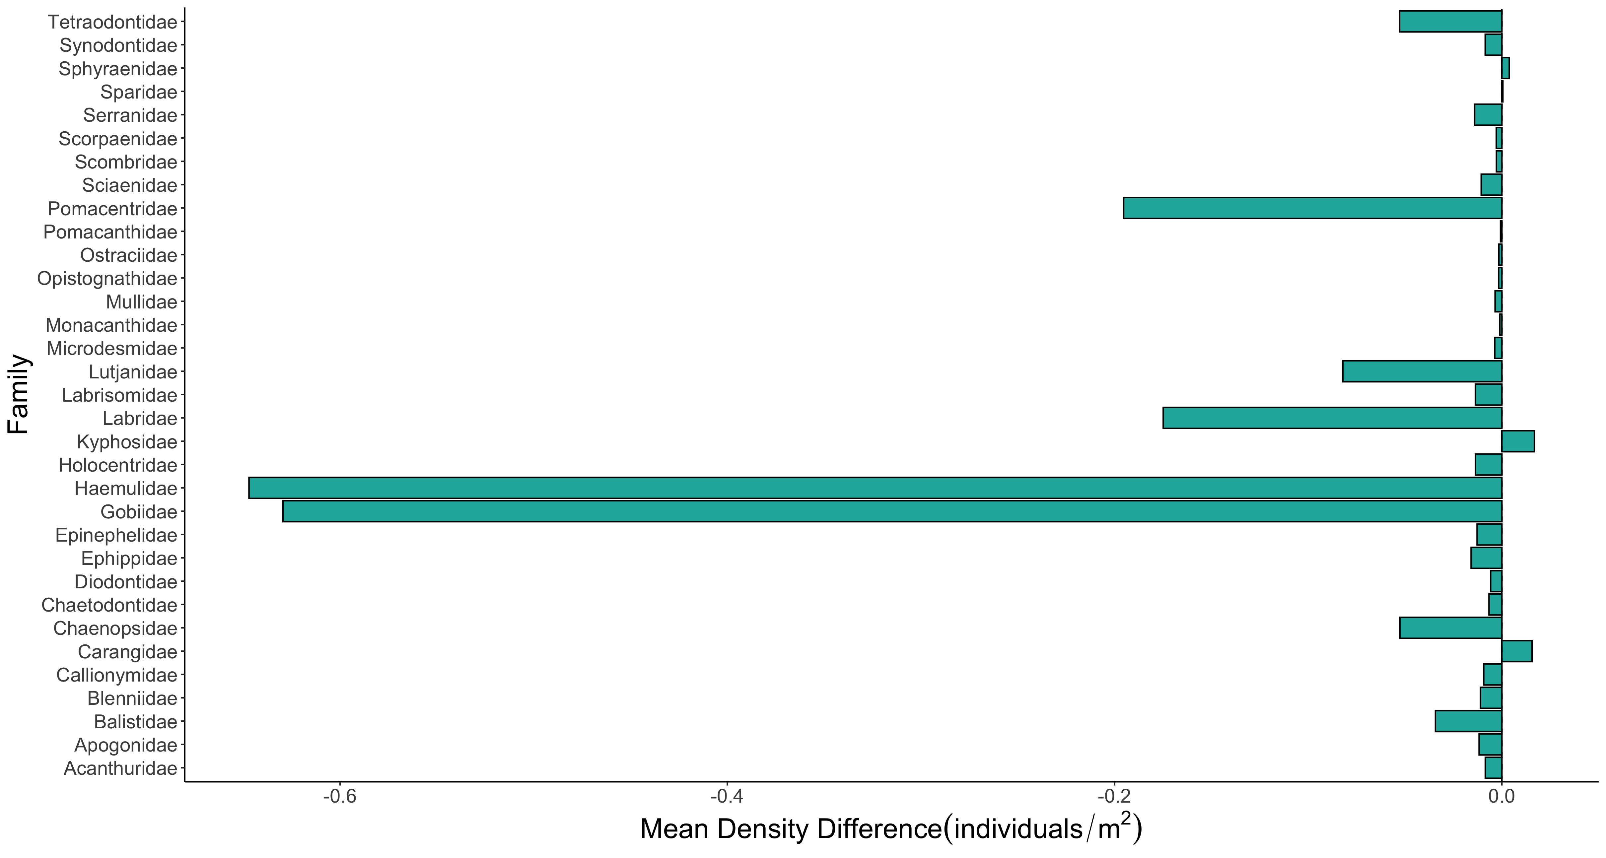

Slide 9
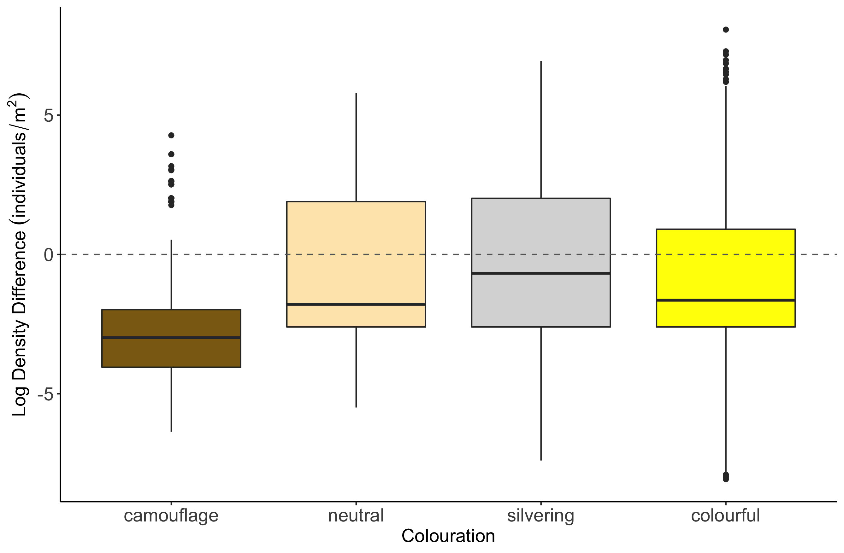
c
b
b
a

Slide 10
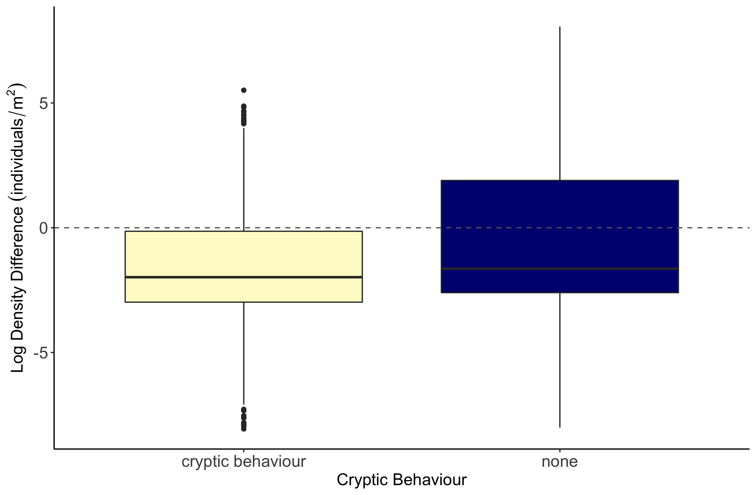
b
a

Slide 11
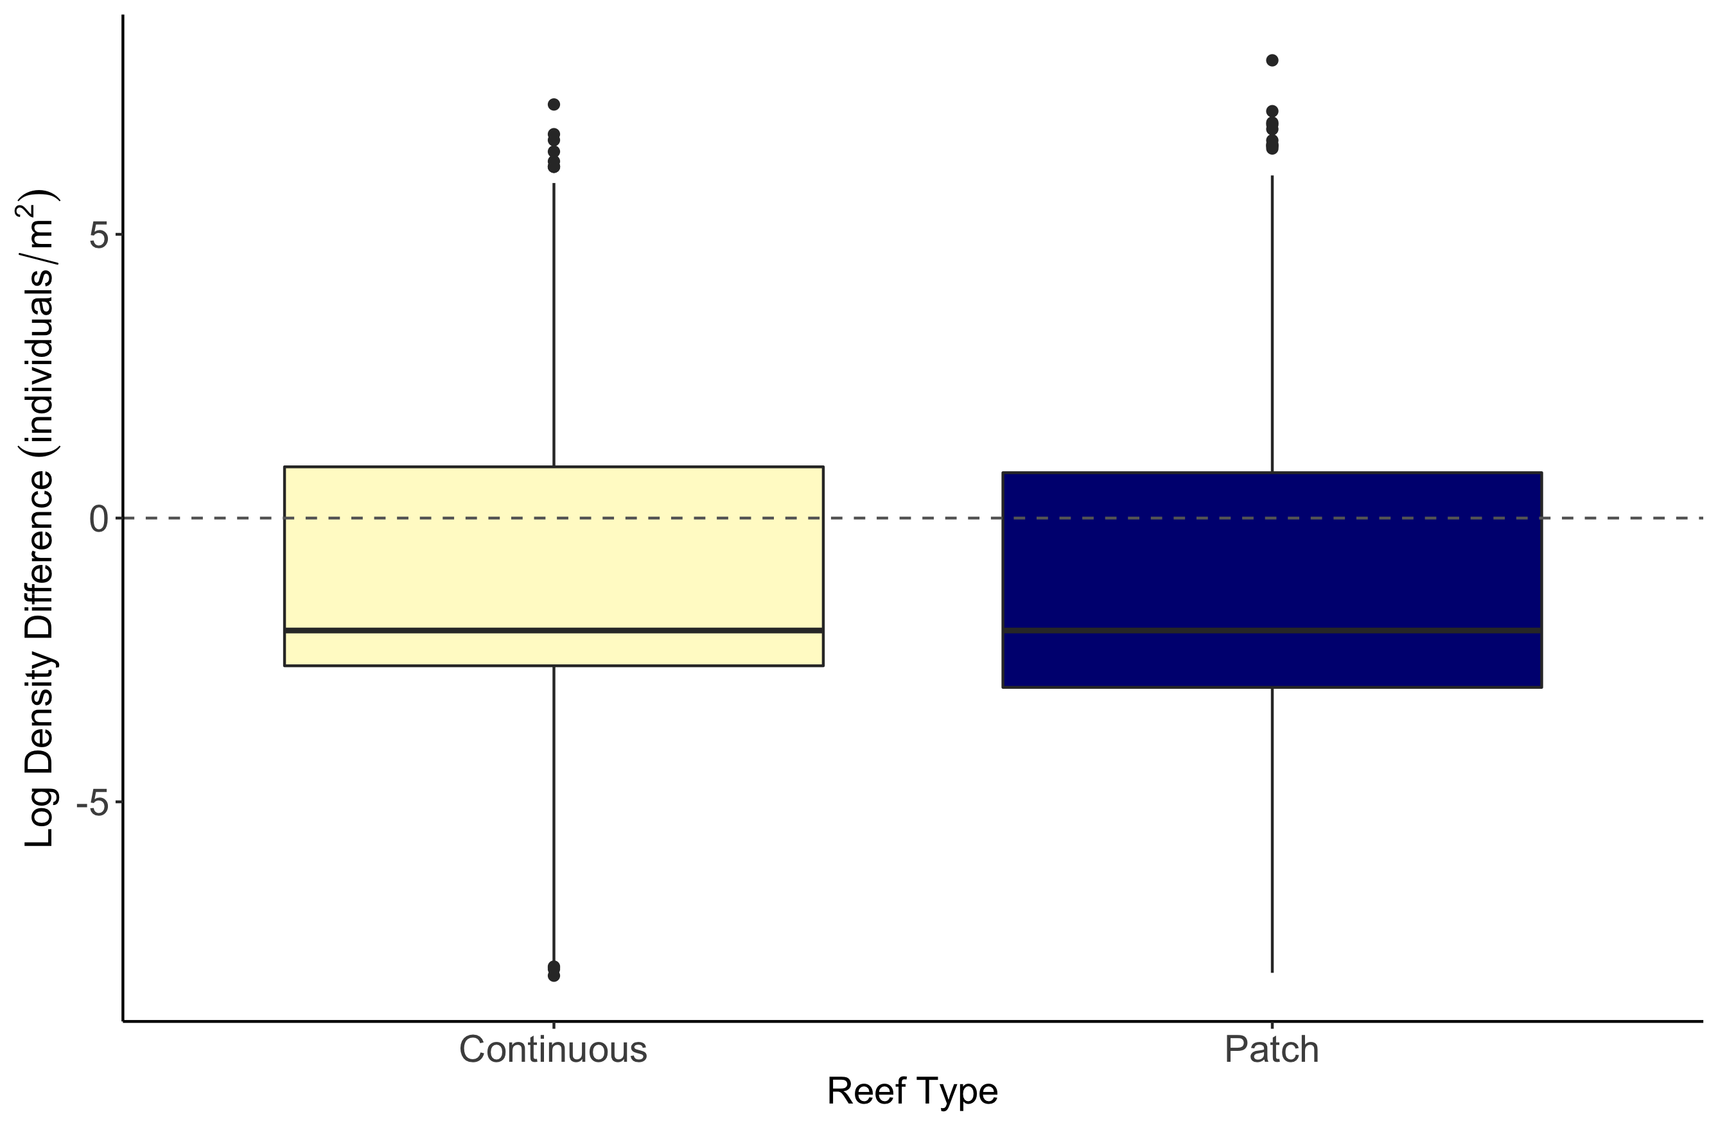
b
a

Slide 12
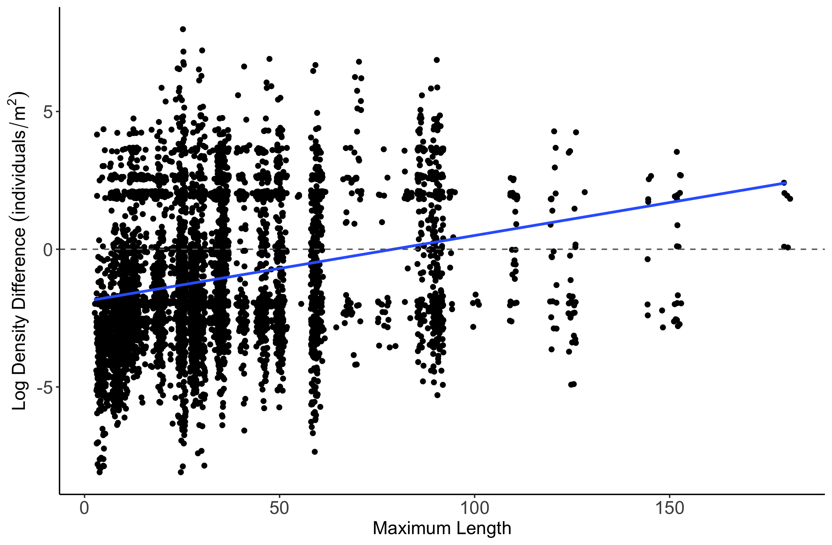
Estimate = 0.0077157
z value = 4.307
p-value = 1.65e-05

Slide 13
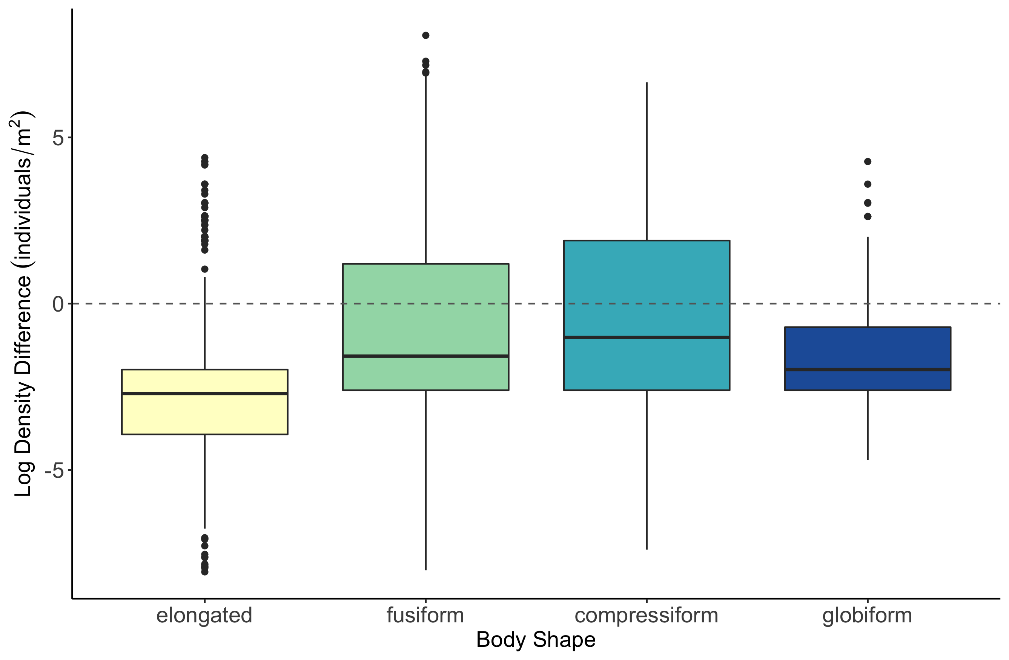
b
c
a
d

Slide 14
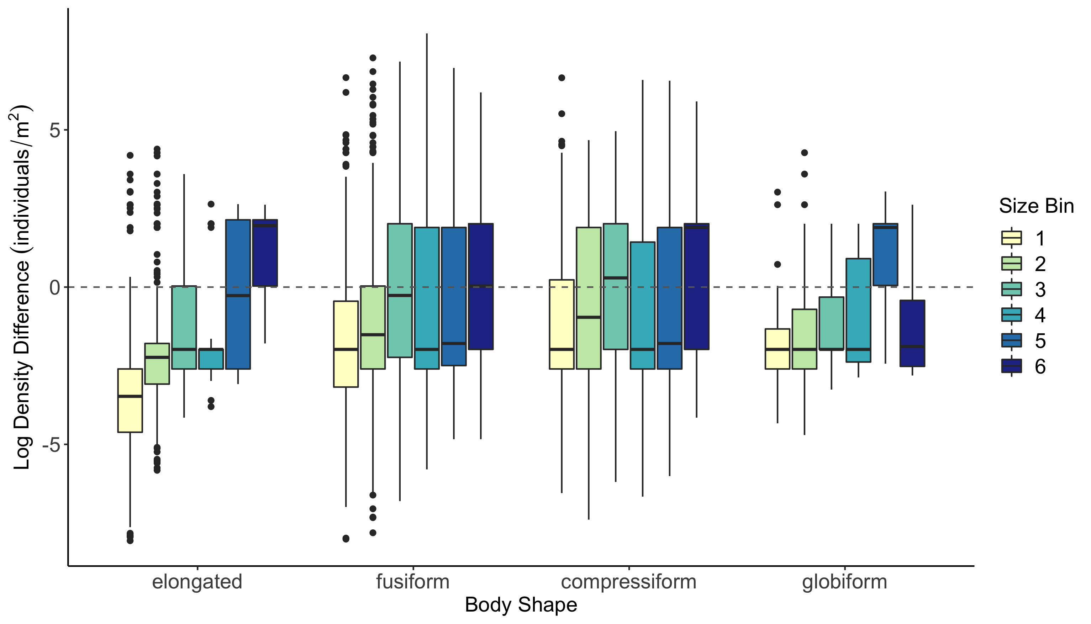

Slide 15
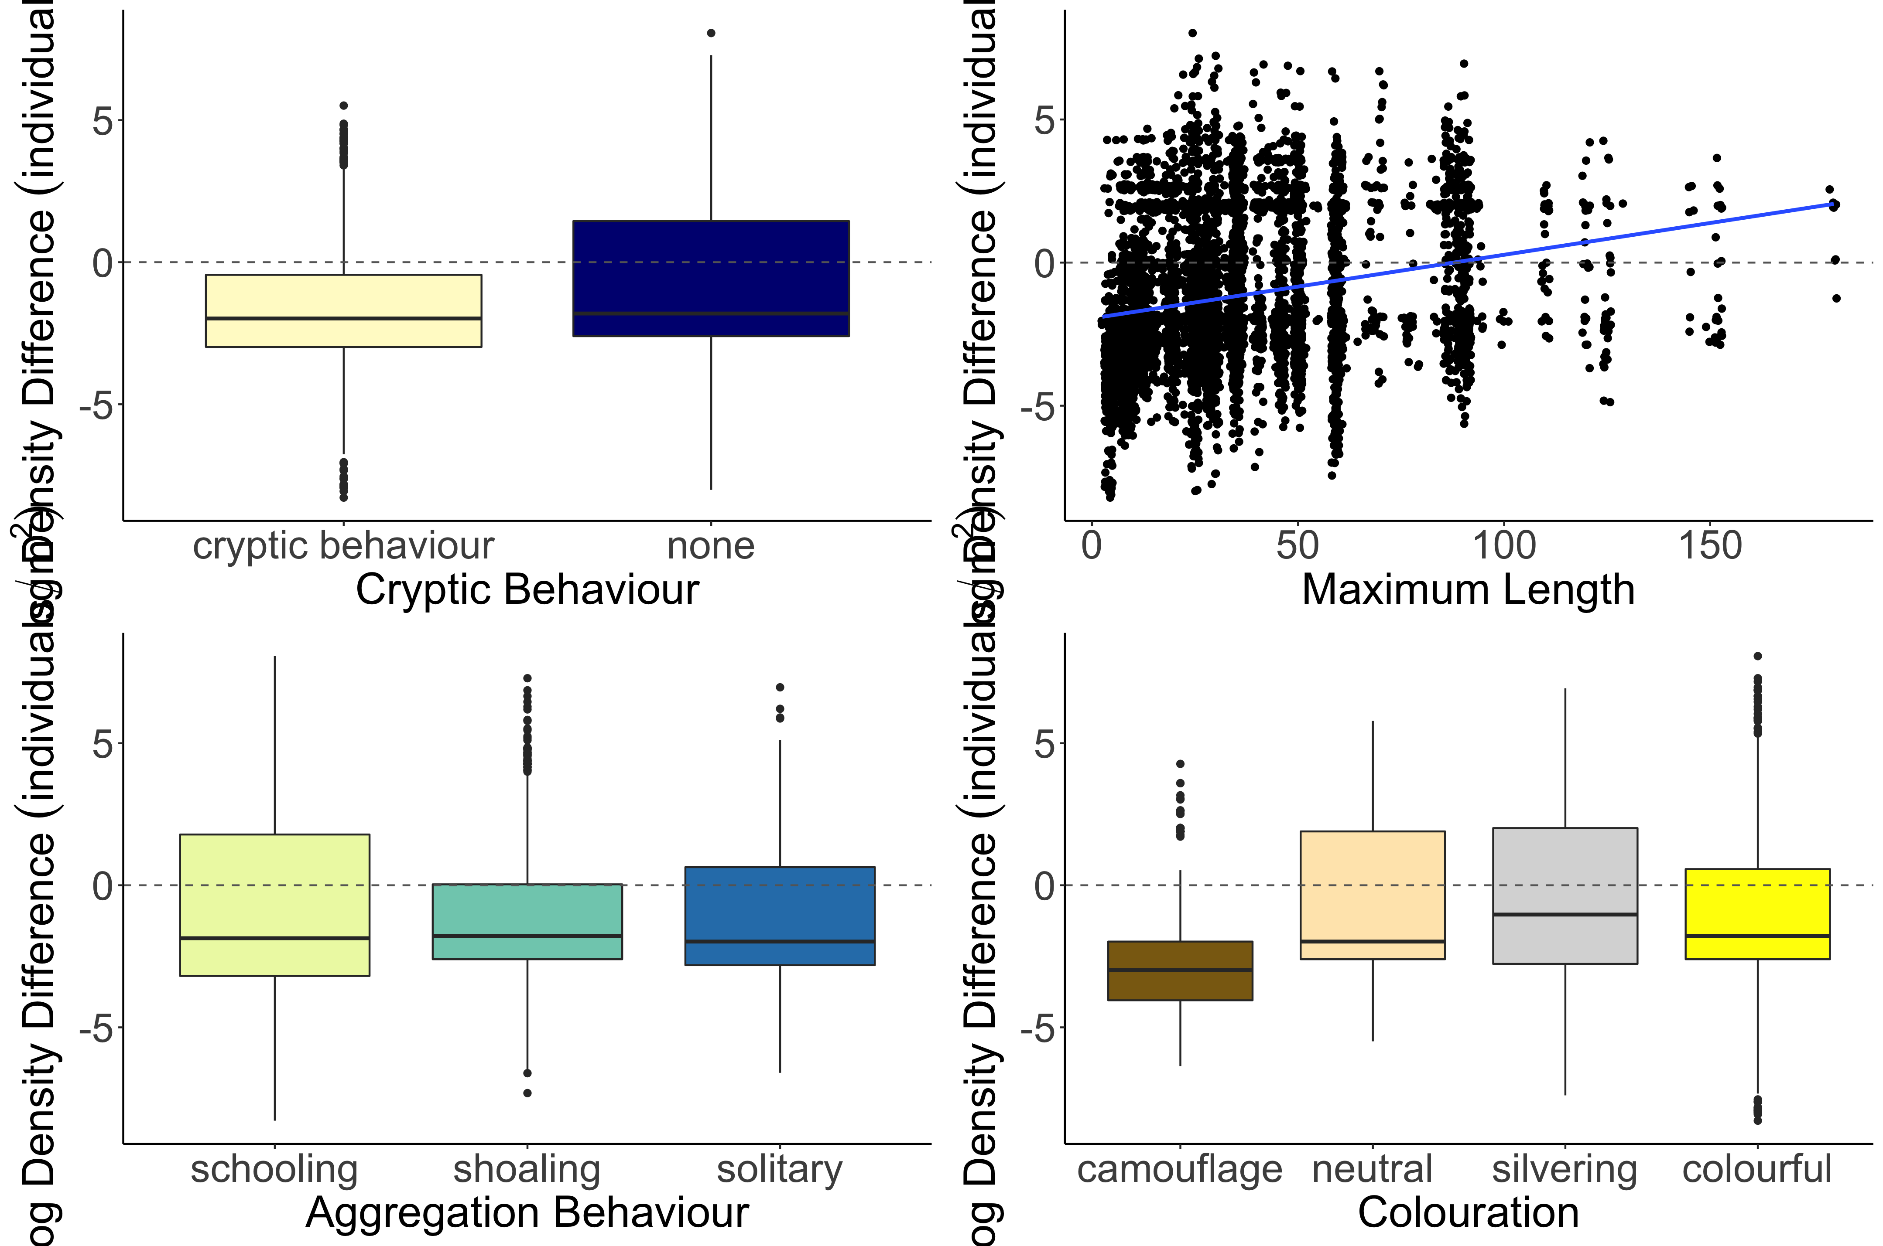
b
Estimate = 0.006355
z value = 3.801
p-value = 0.000144
a
Log Density Difference (individuals/m²)
c
b
b
a

Slide 16
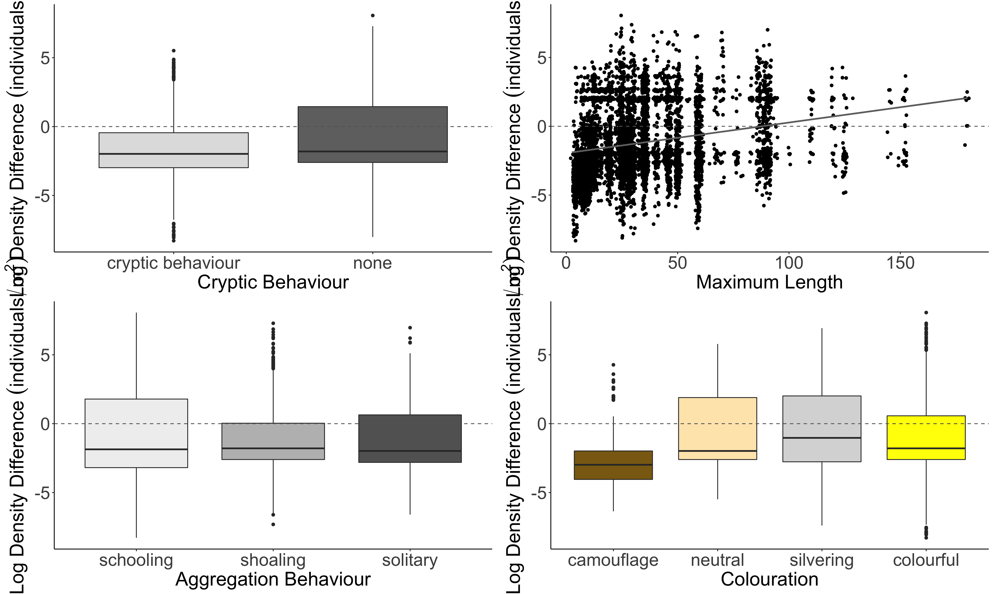
A.
b
B.
Estimate = 0.006355
z value = 3.801
p-value = 0.000144
a
C.
D.
Log Density Difference (individuals/m²)
c
b
b
a

Slide 17
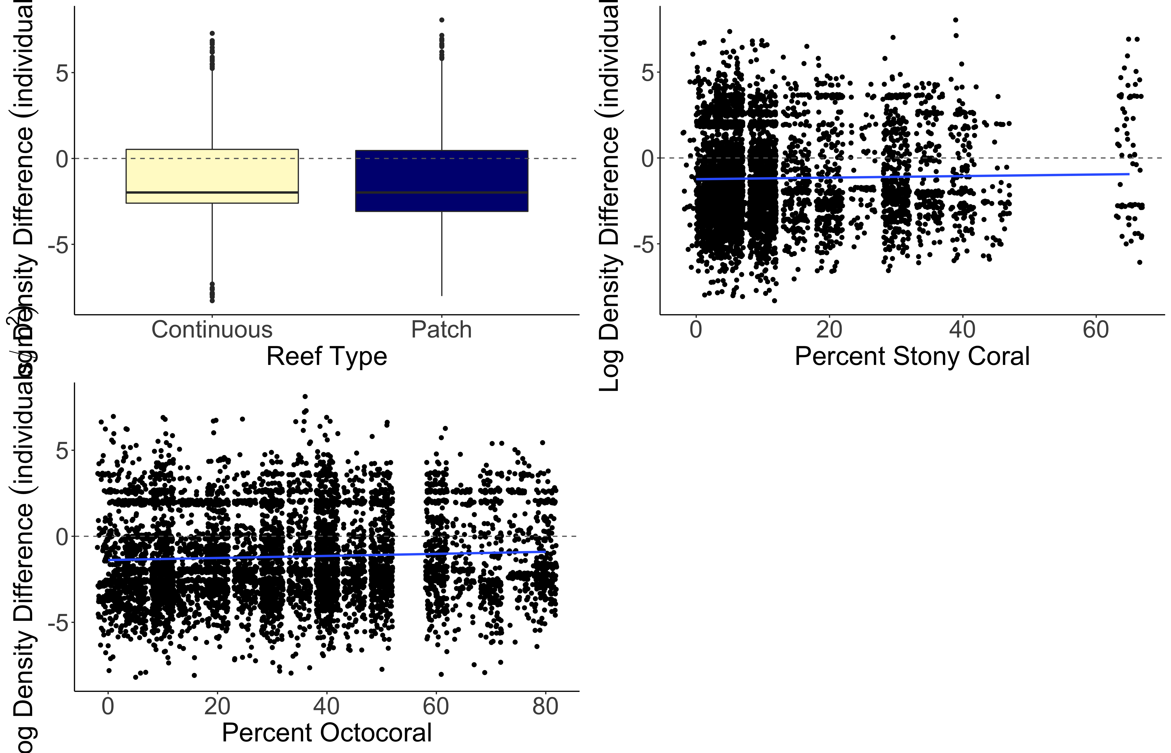
a
b
Estimate = 0.015630
z value = 4.570
p-value = 4.9e-06
Log Density Difference (individuals/m²)
Estimate = 0.009786
z value = 6.254
p-value = < 2e-16

Slide 18
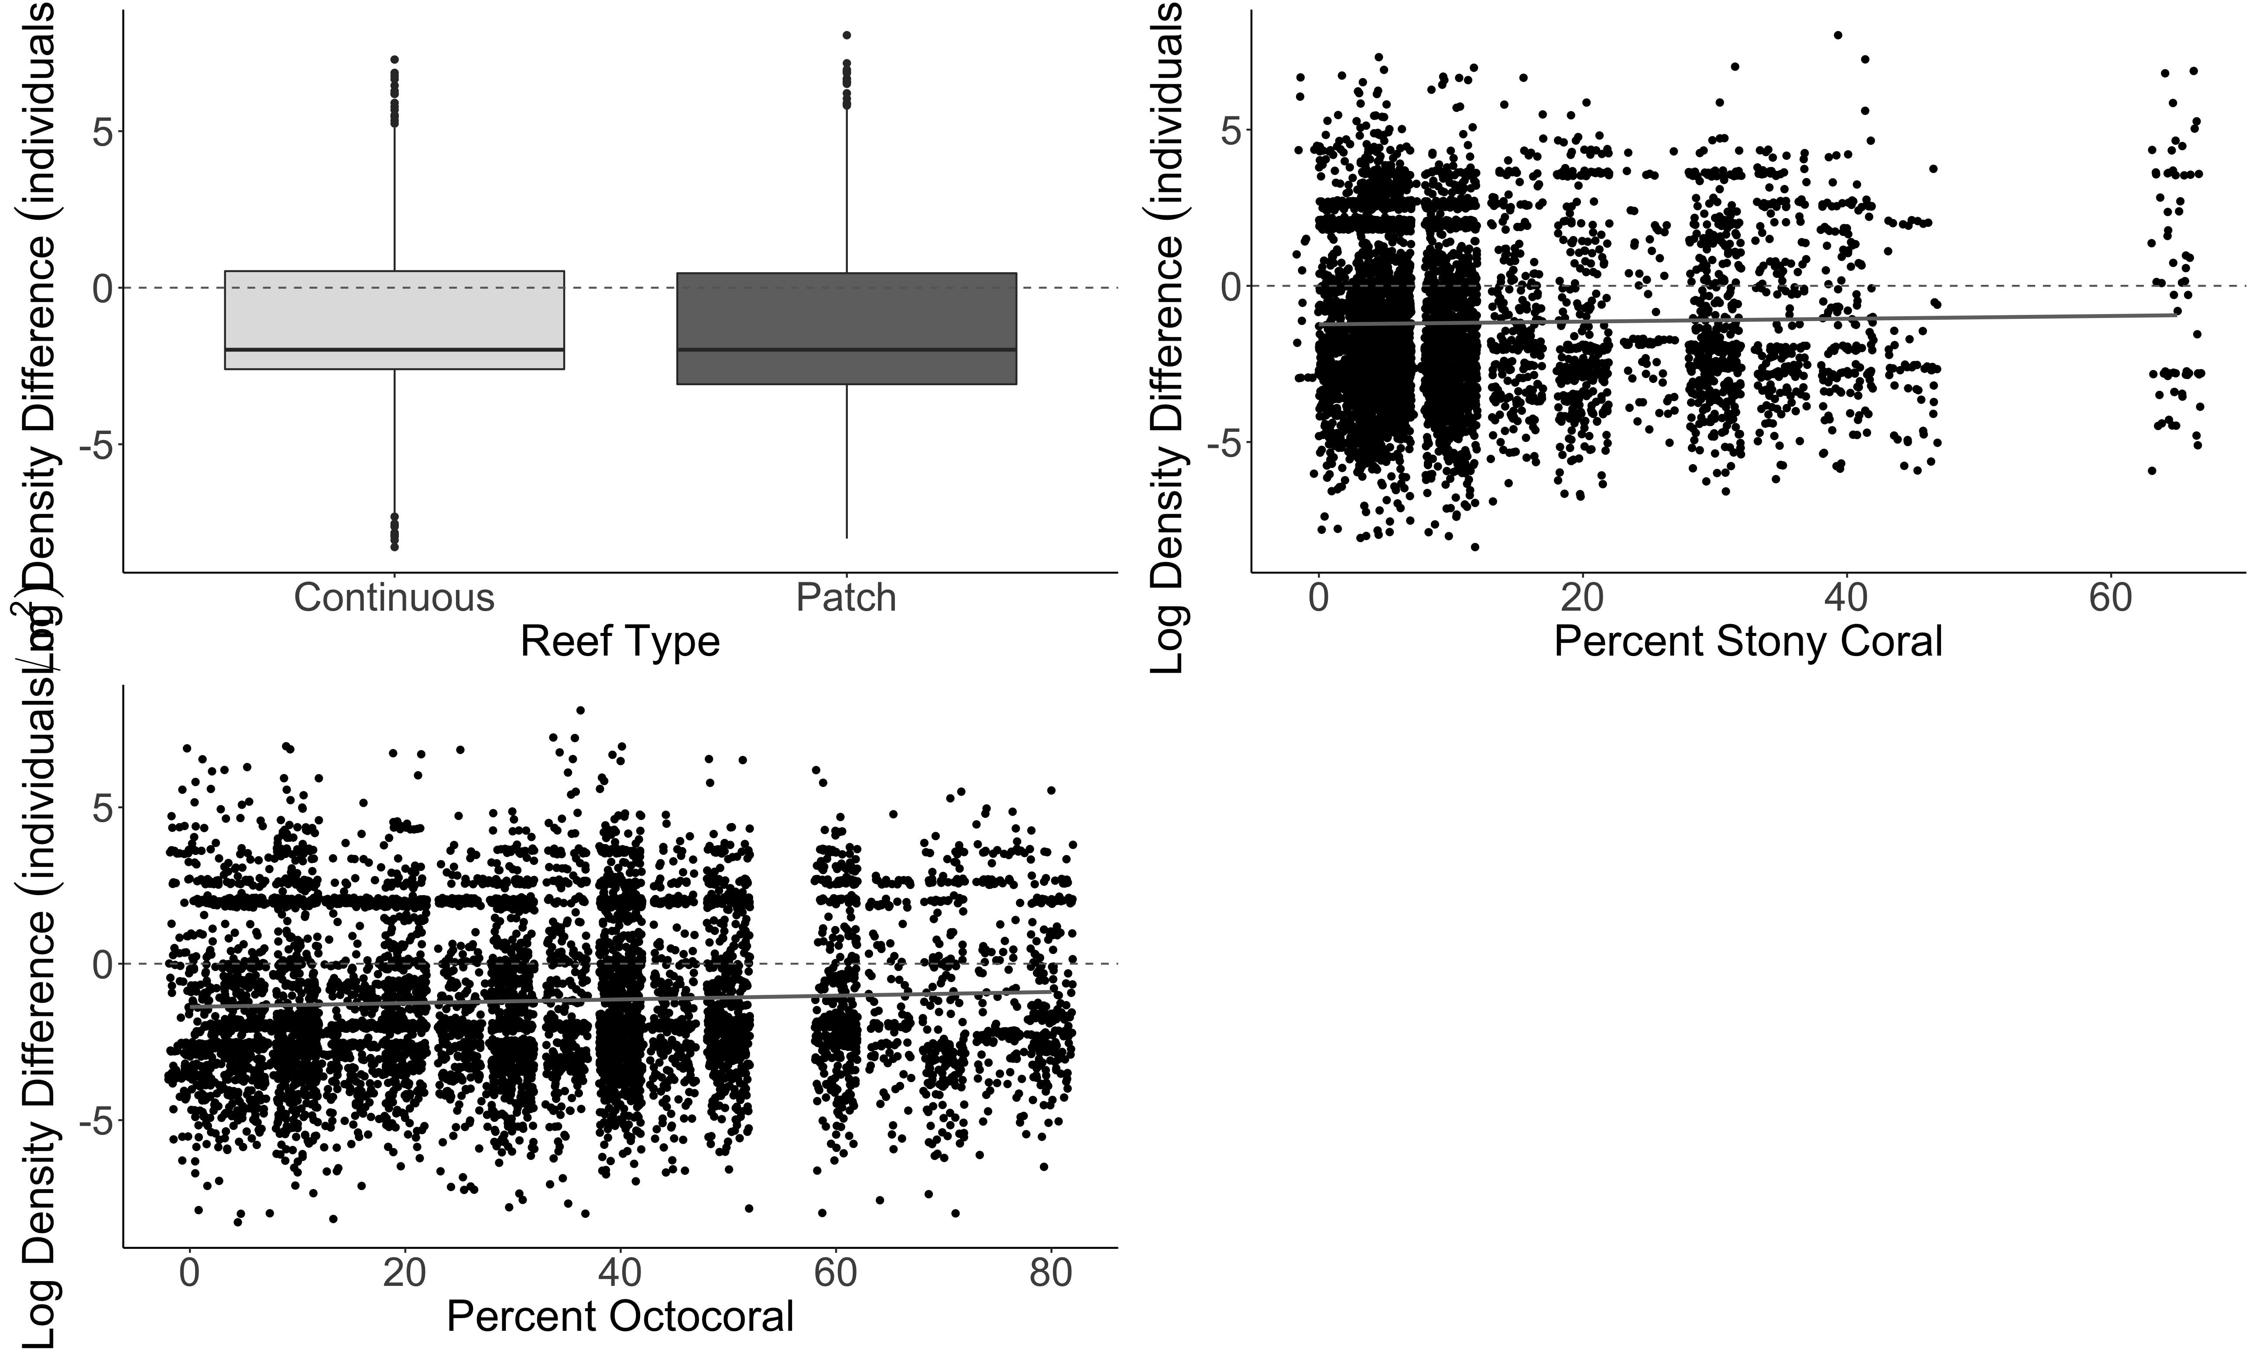
A.
B.
a
b
Estimate = 0.015630
z value = 4.570
p-value = 4.9e-06
Log Density Difference (individuals/m²)
C.
Estimate = 0.009786
z value = 6.254
p-value = < 2e-16

Slide 19
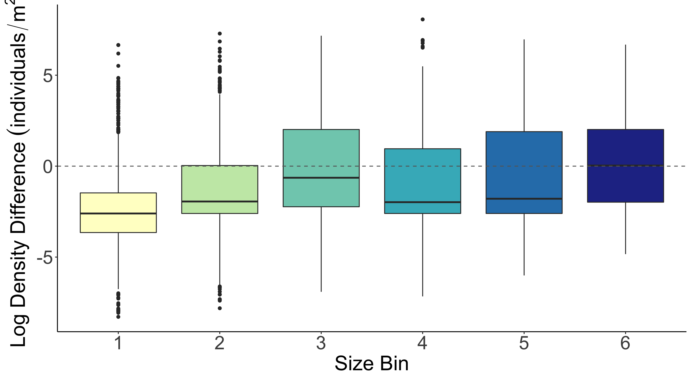
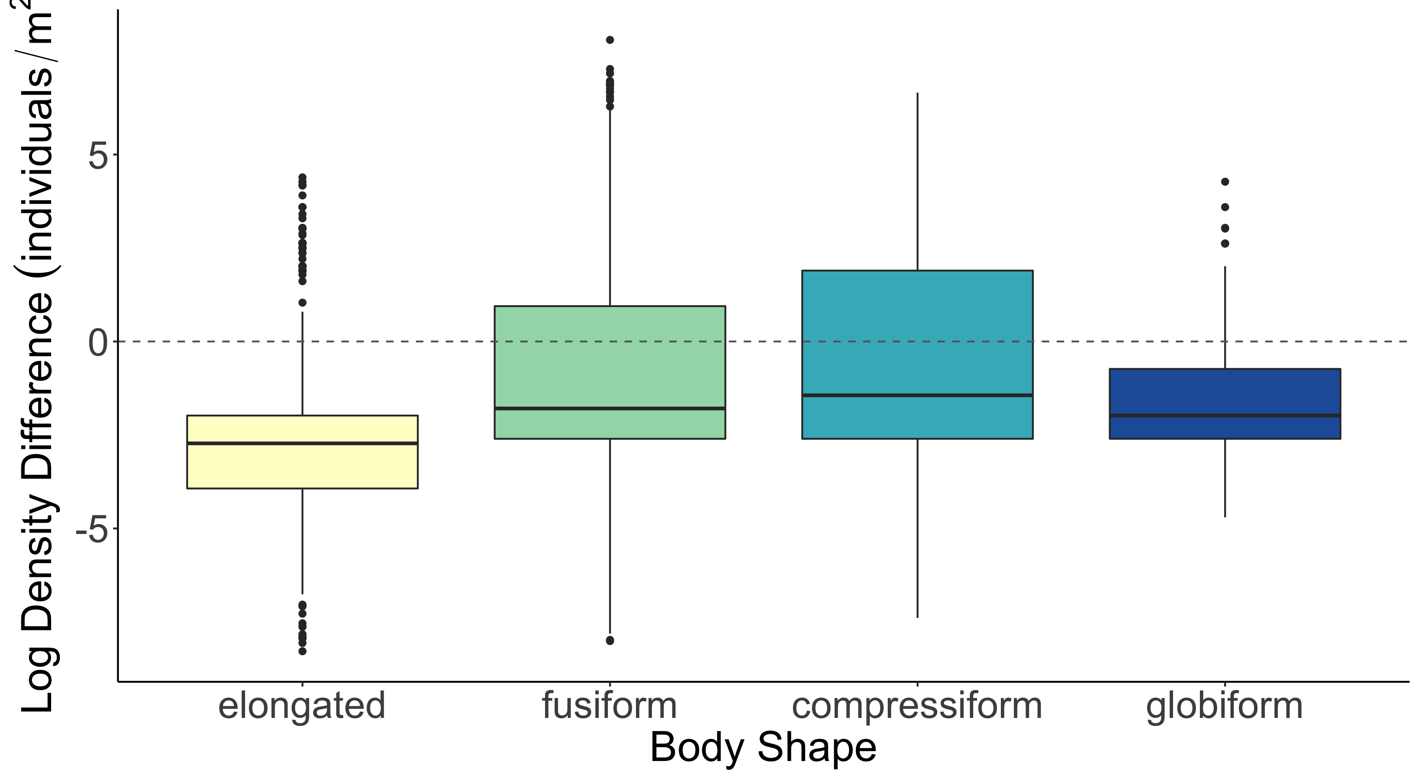
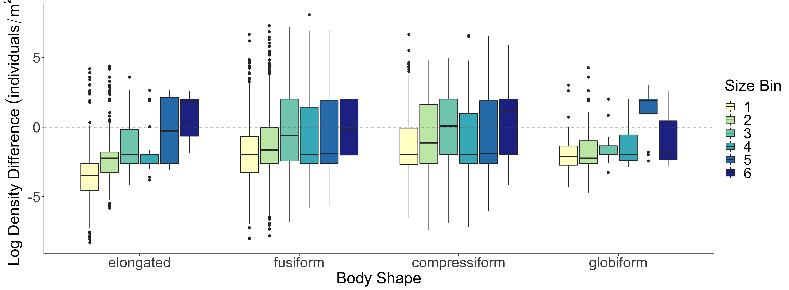
b
b
a
b
c
d
c
c
a
d
b
c
Log Density Difference (individuals/m²)
a
d

Slide 20
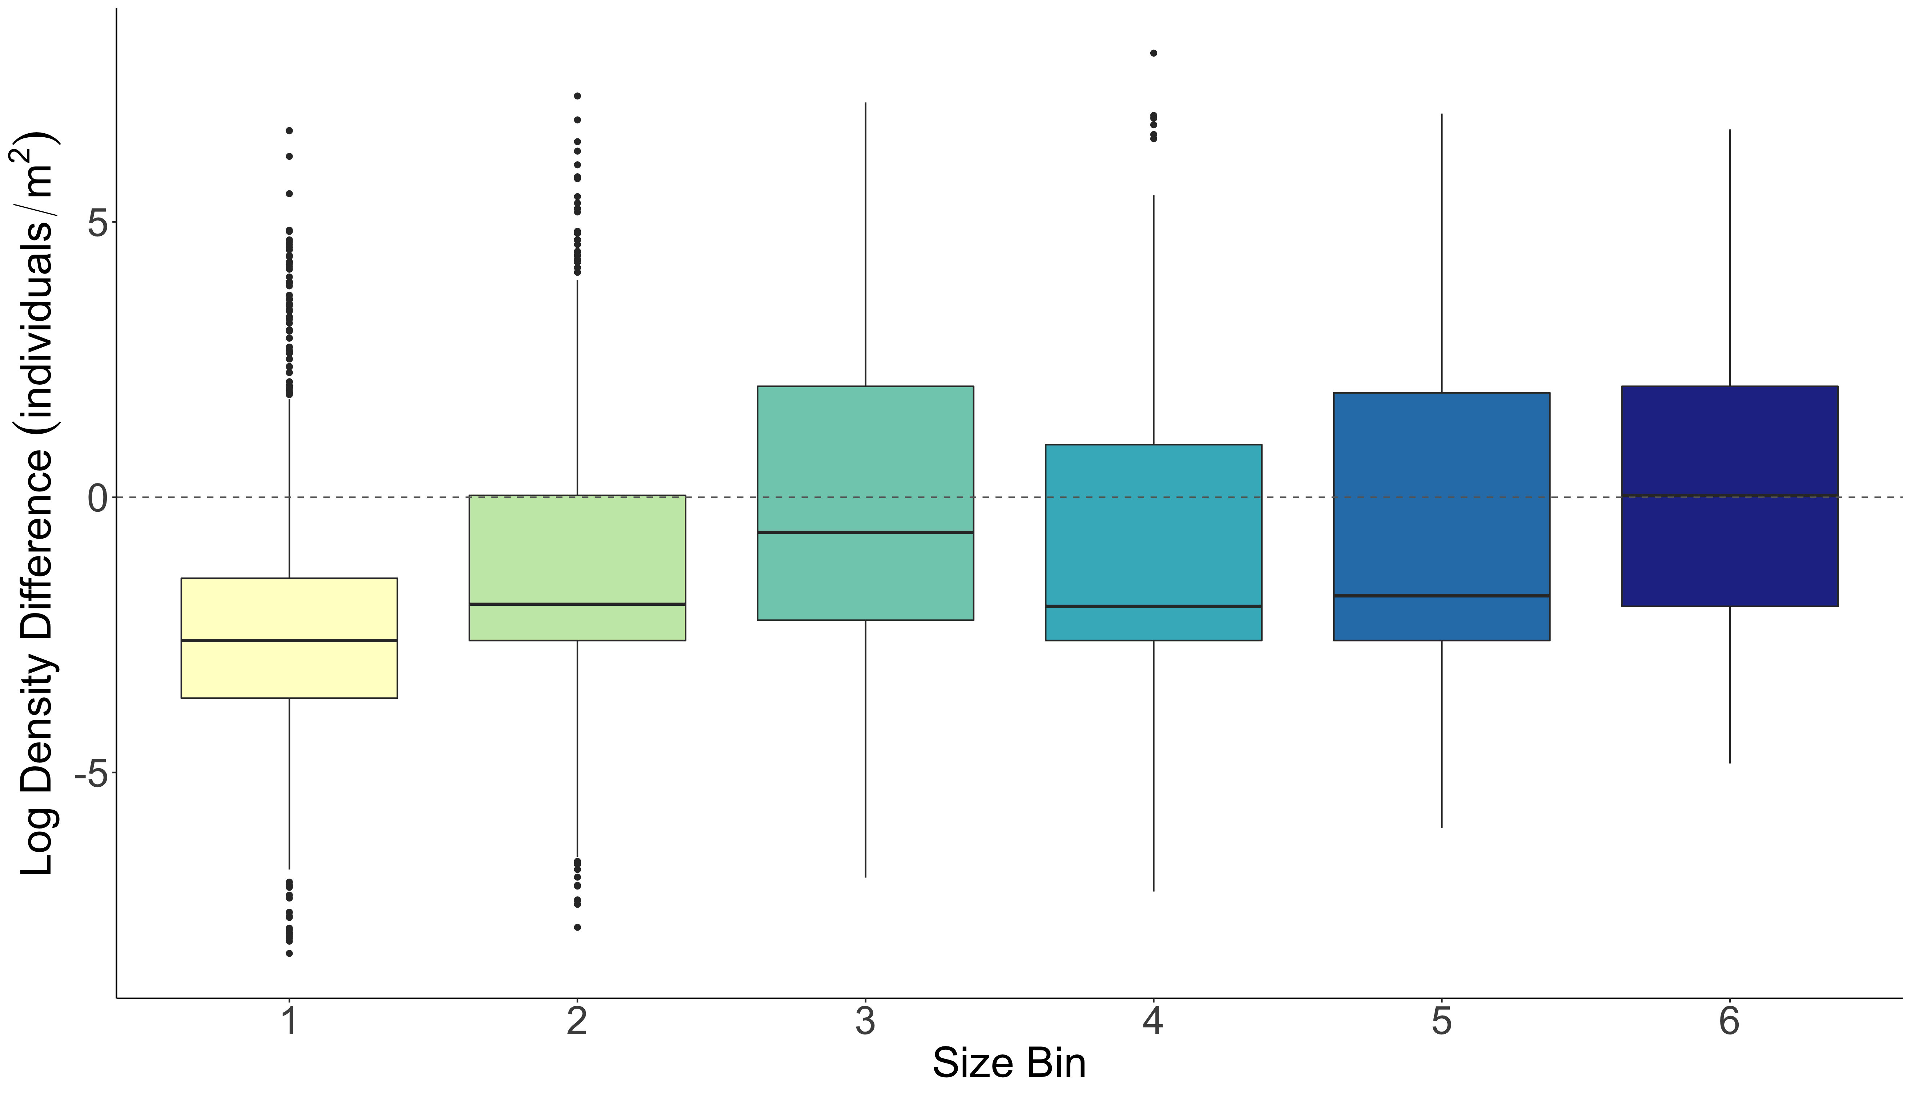
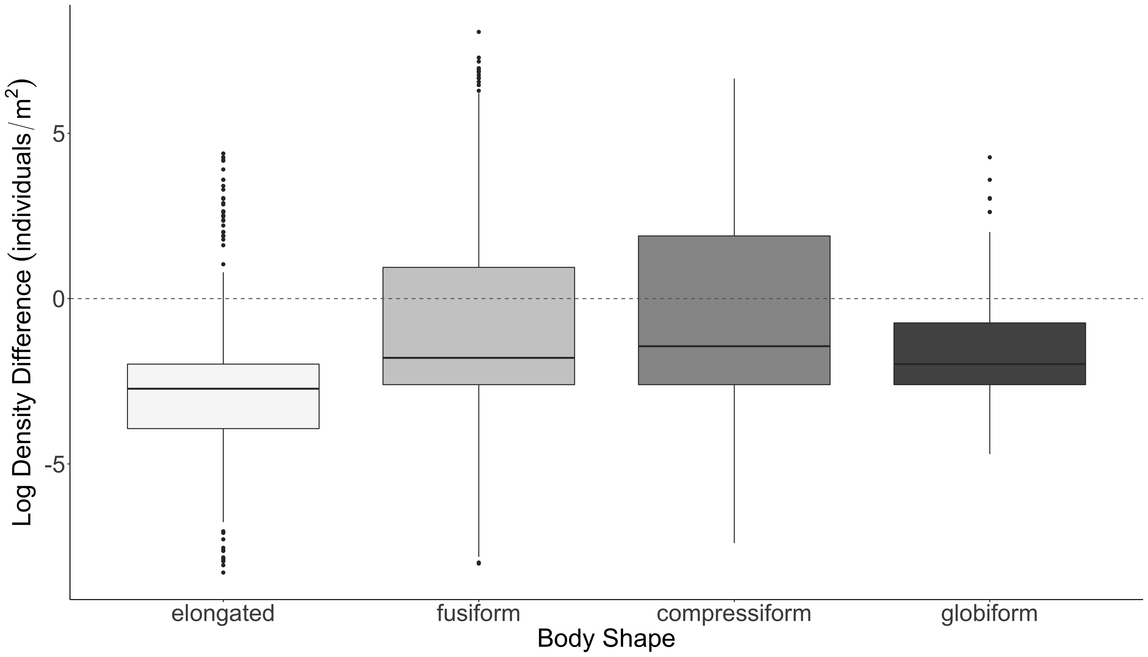
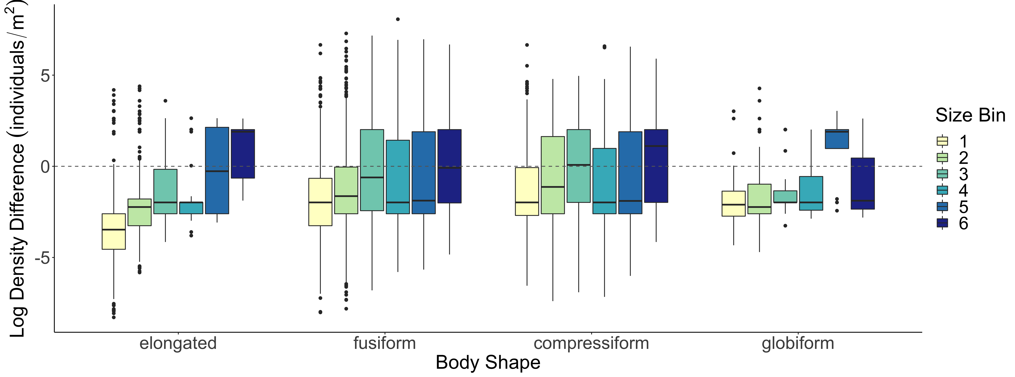
A.
b
c
b
B.
b
a
d
c
c
a
d
C.
Log Density Difference (individuals/m²)

Slide 21
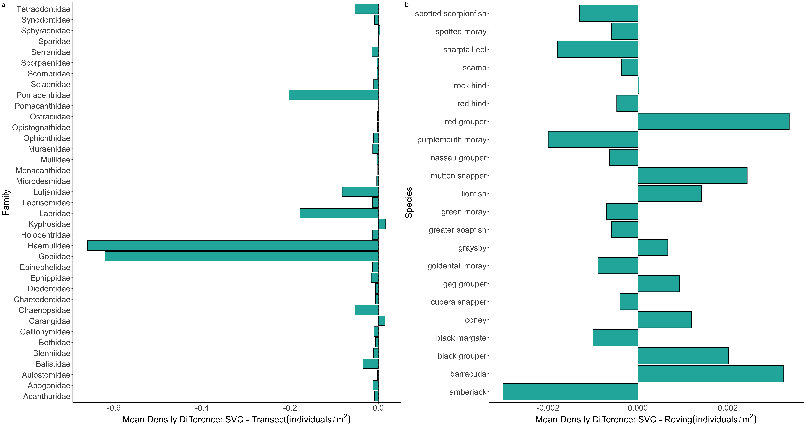
a
b

Slide 22
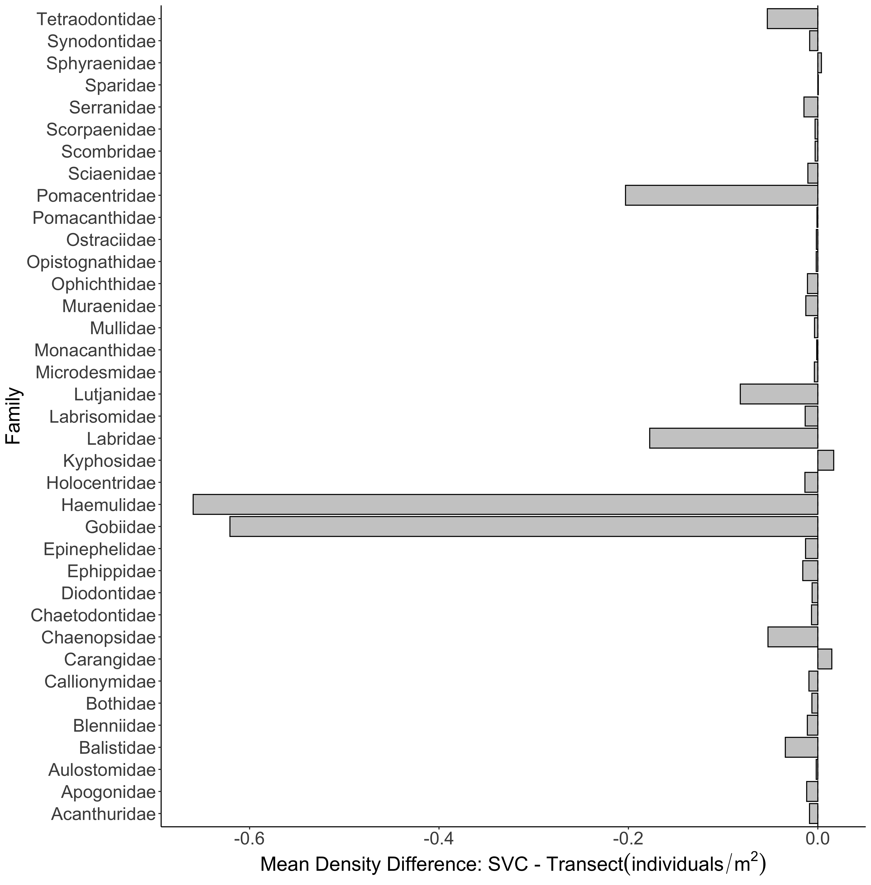
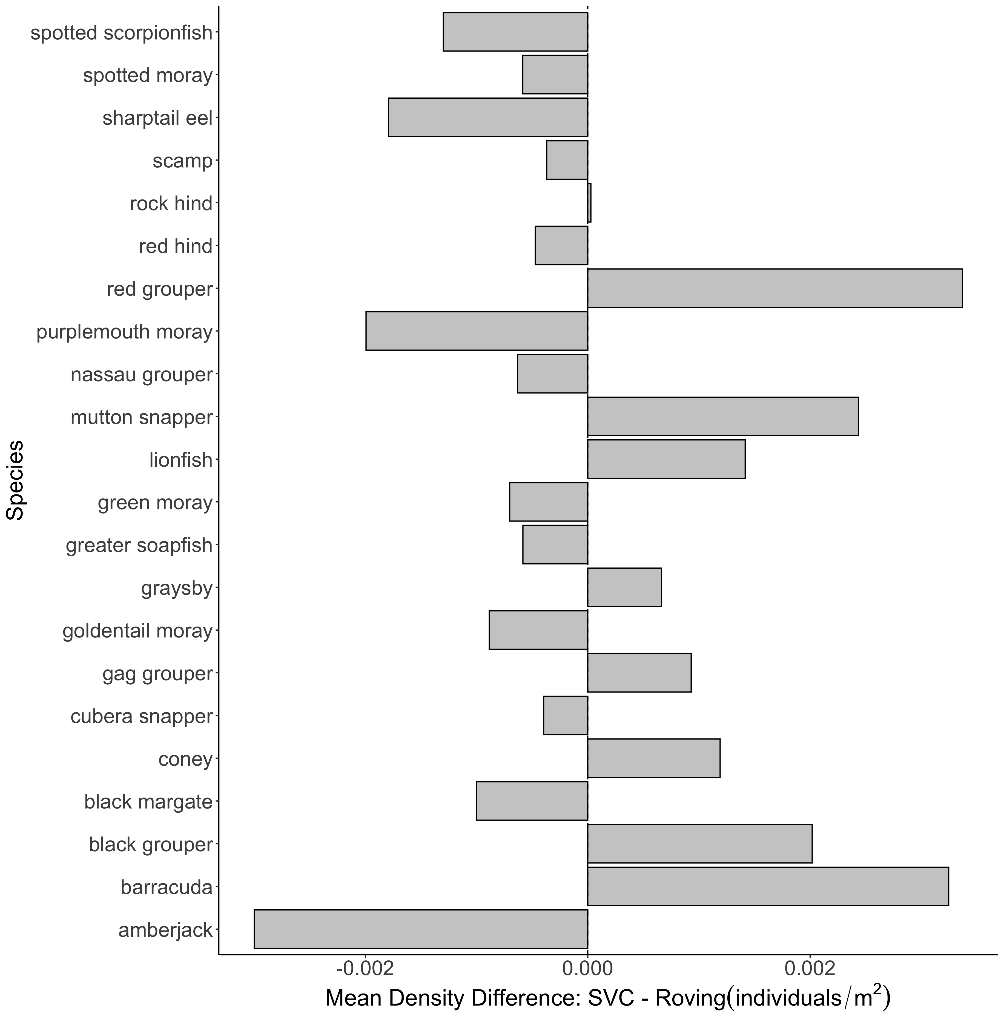
A.
B.

Slide 23
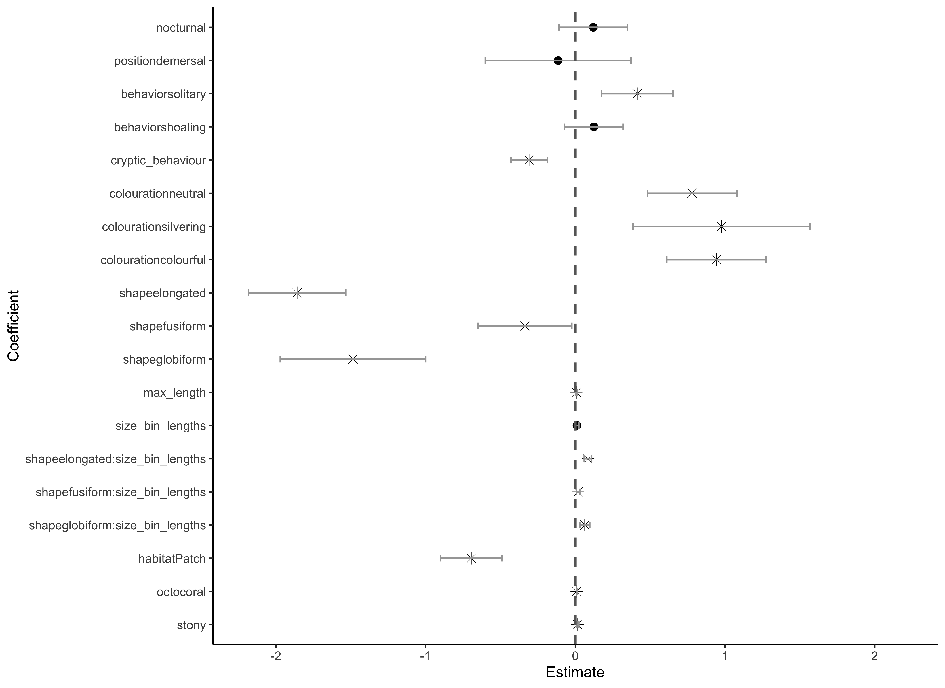
Aggregation
Coloration
Species Traits
Shape
Size*Shape
Habitat Traits

Slide 24
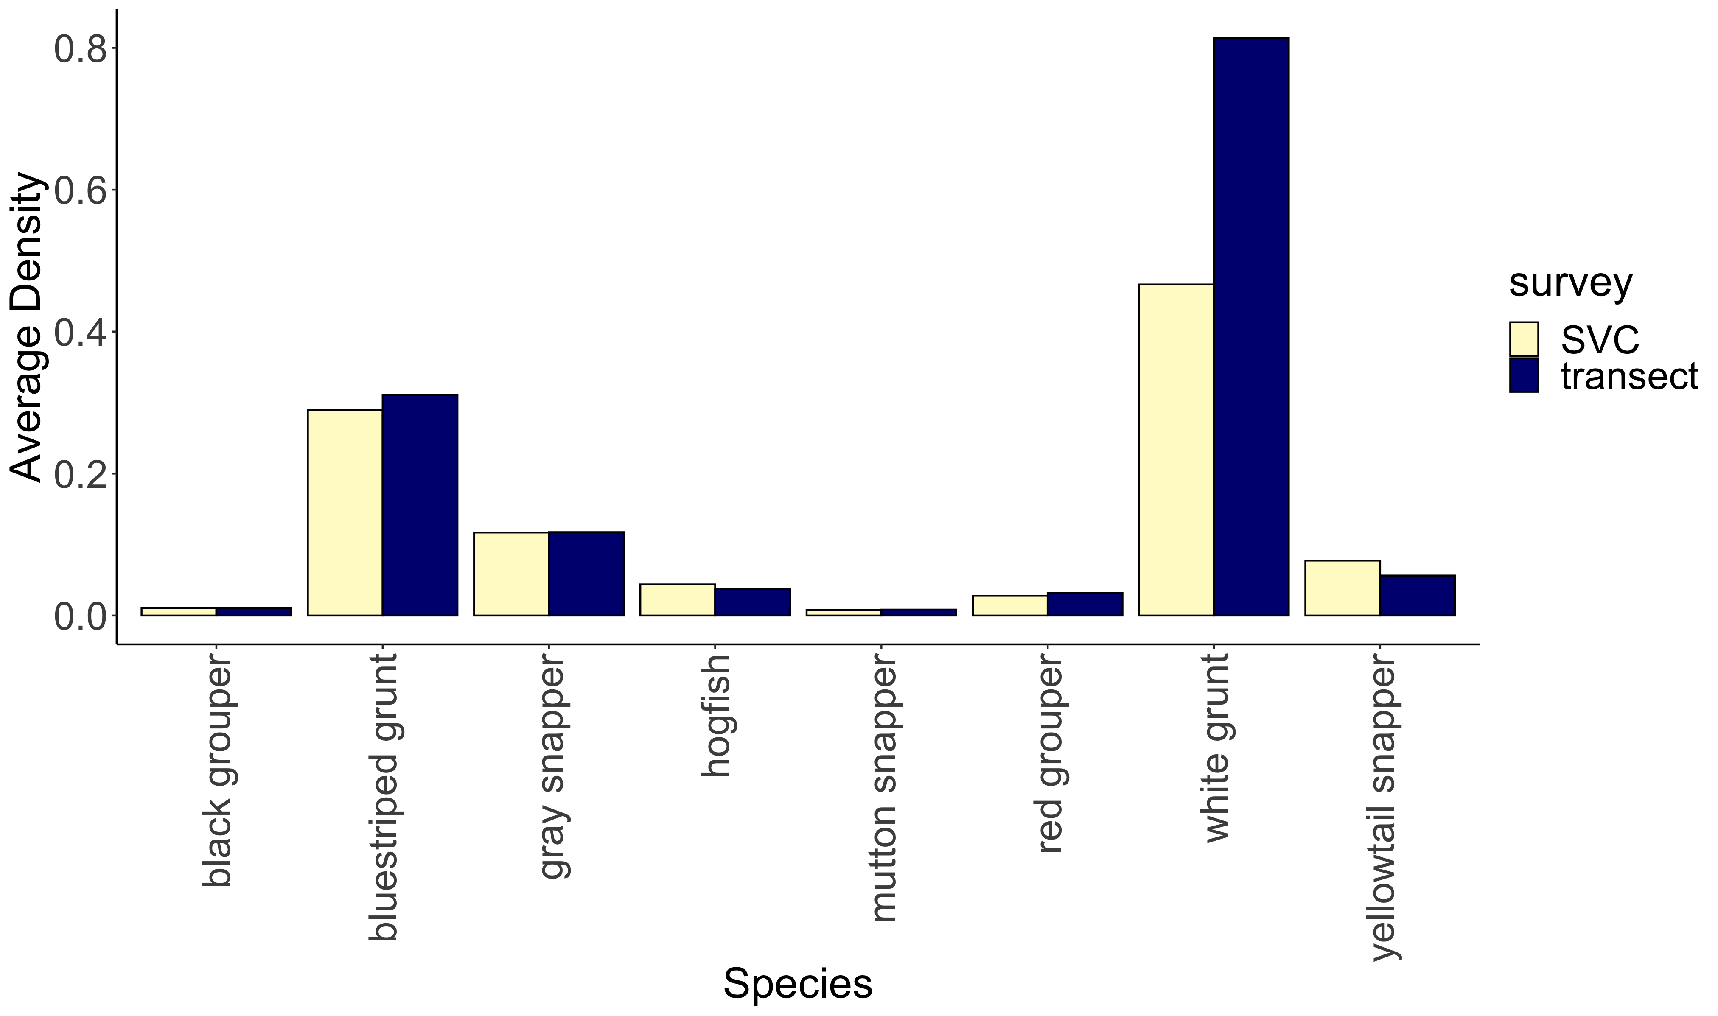
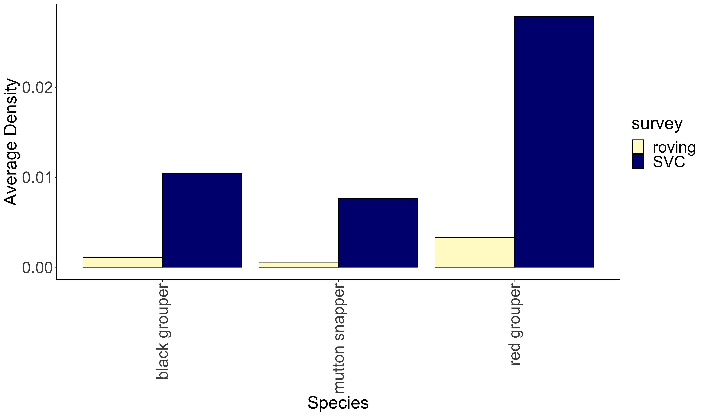
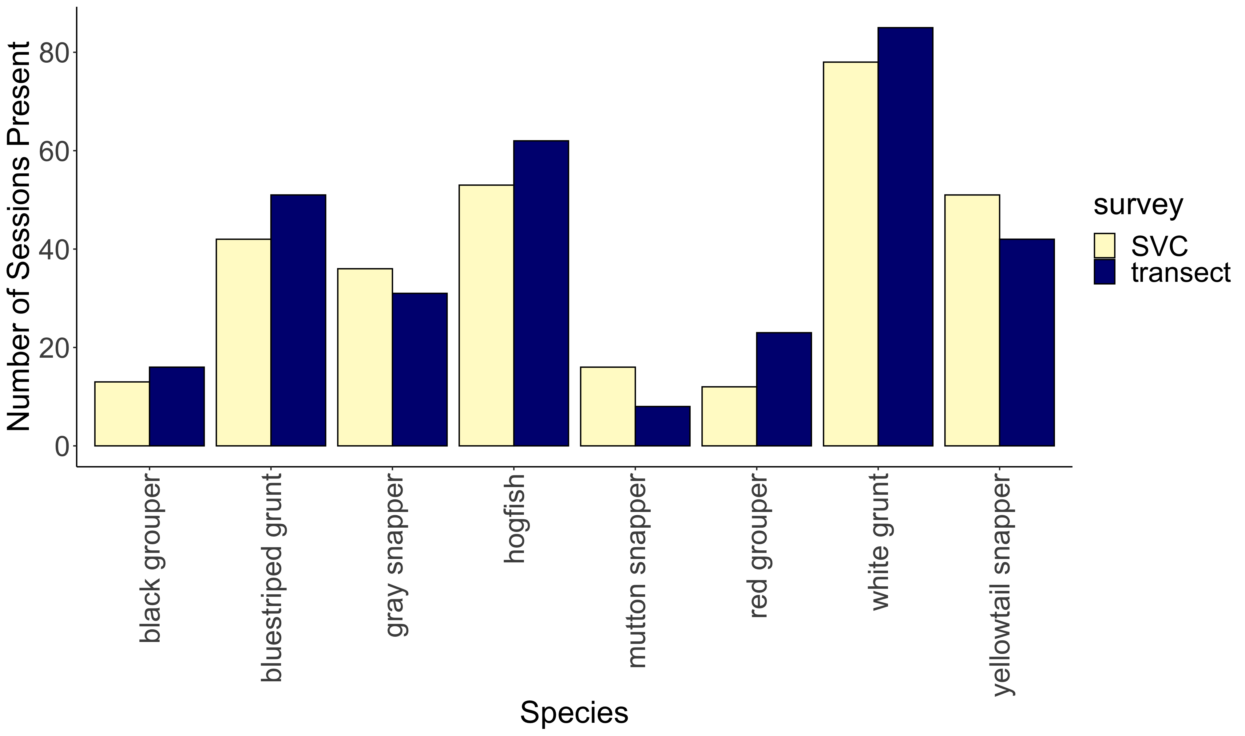
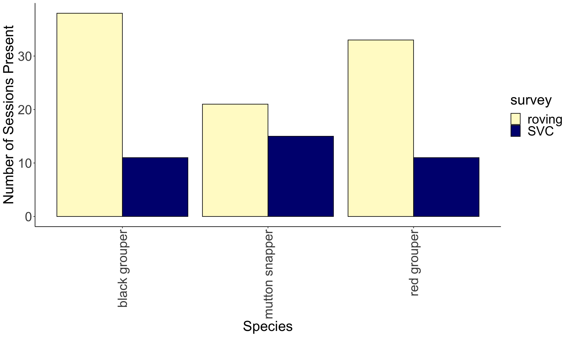
a
**
b
**
**
***
c
d
***
***

Slide 25
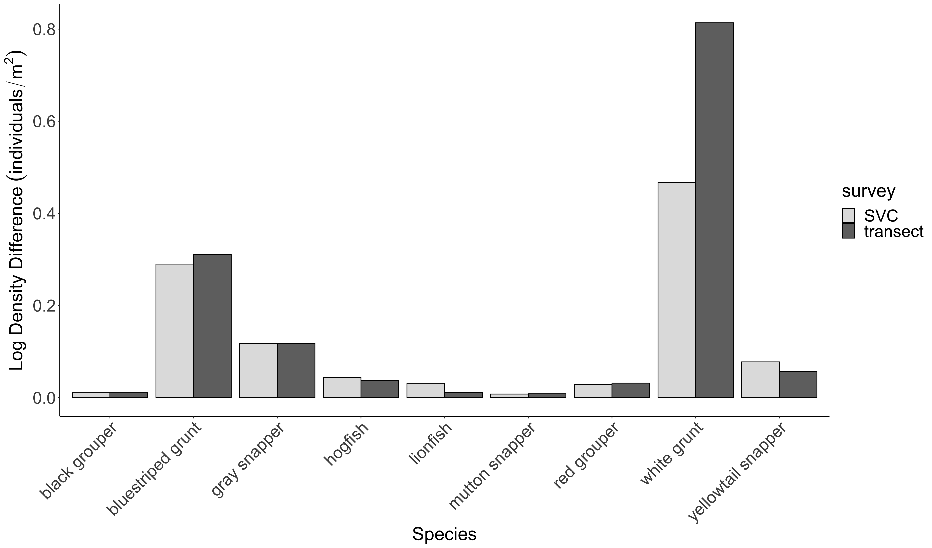
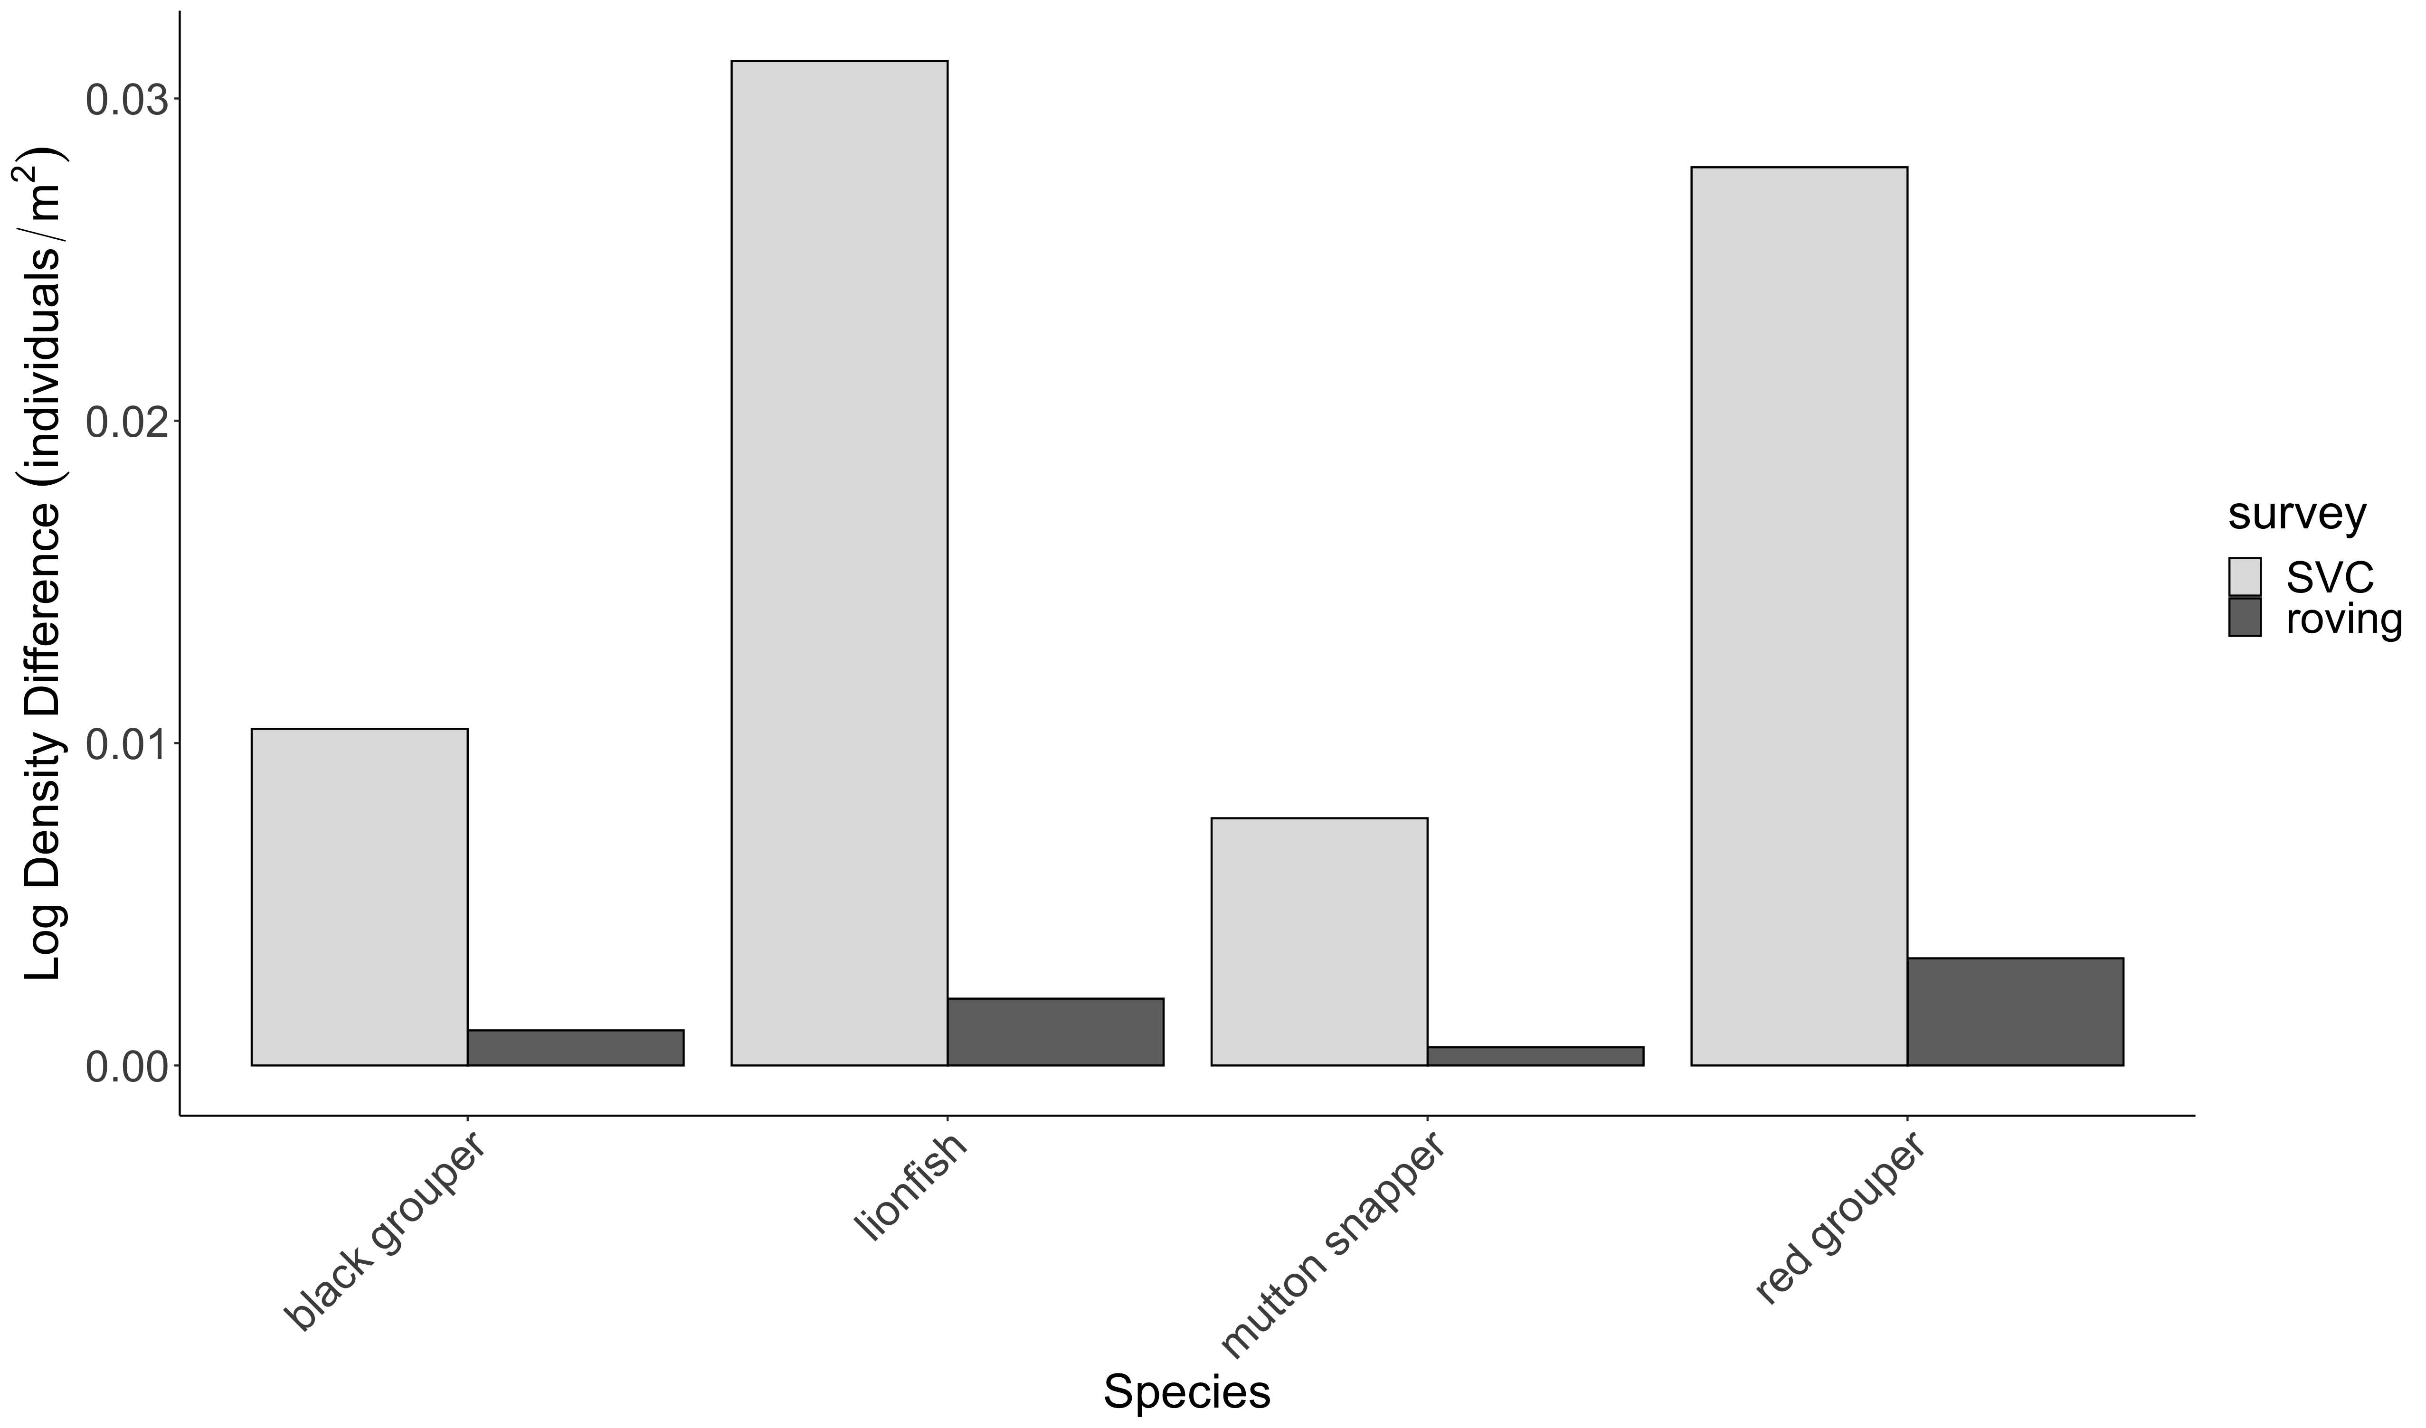
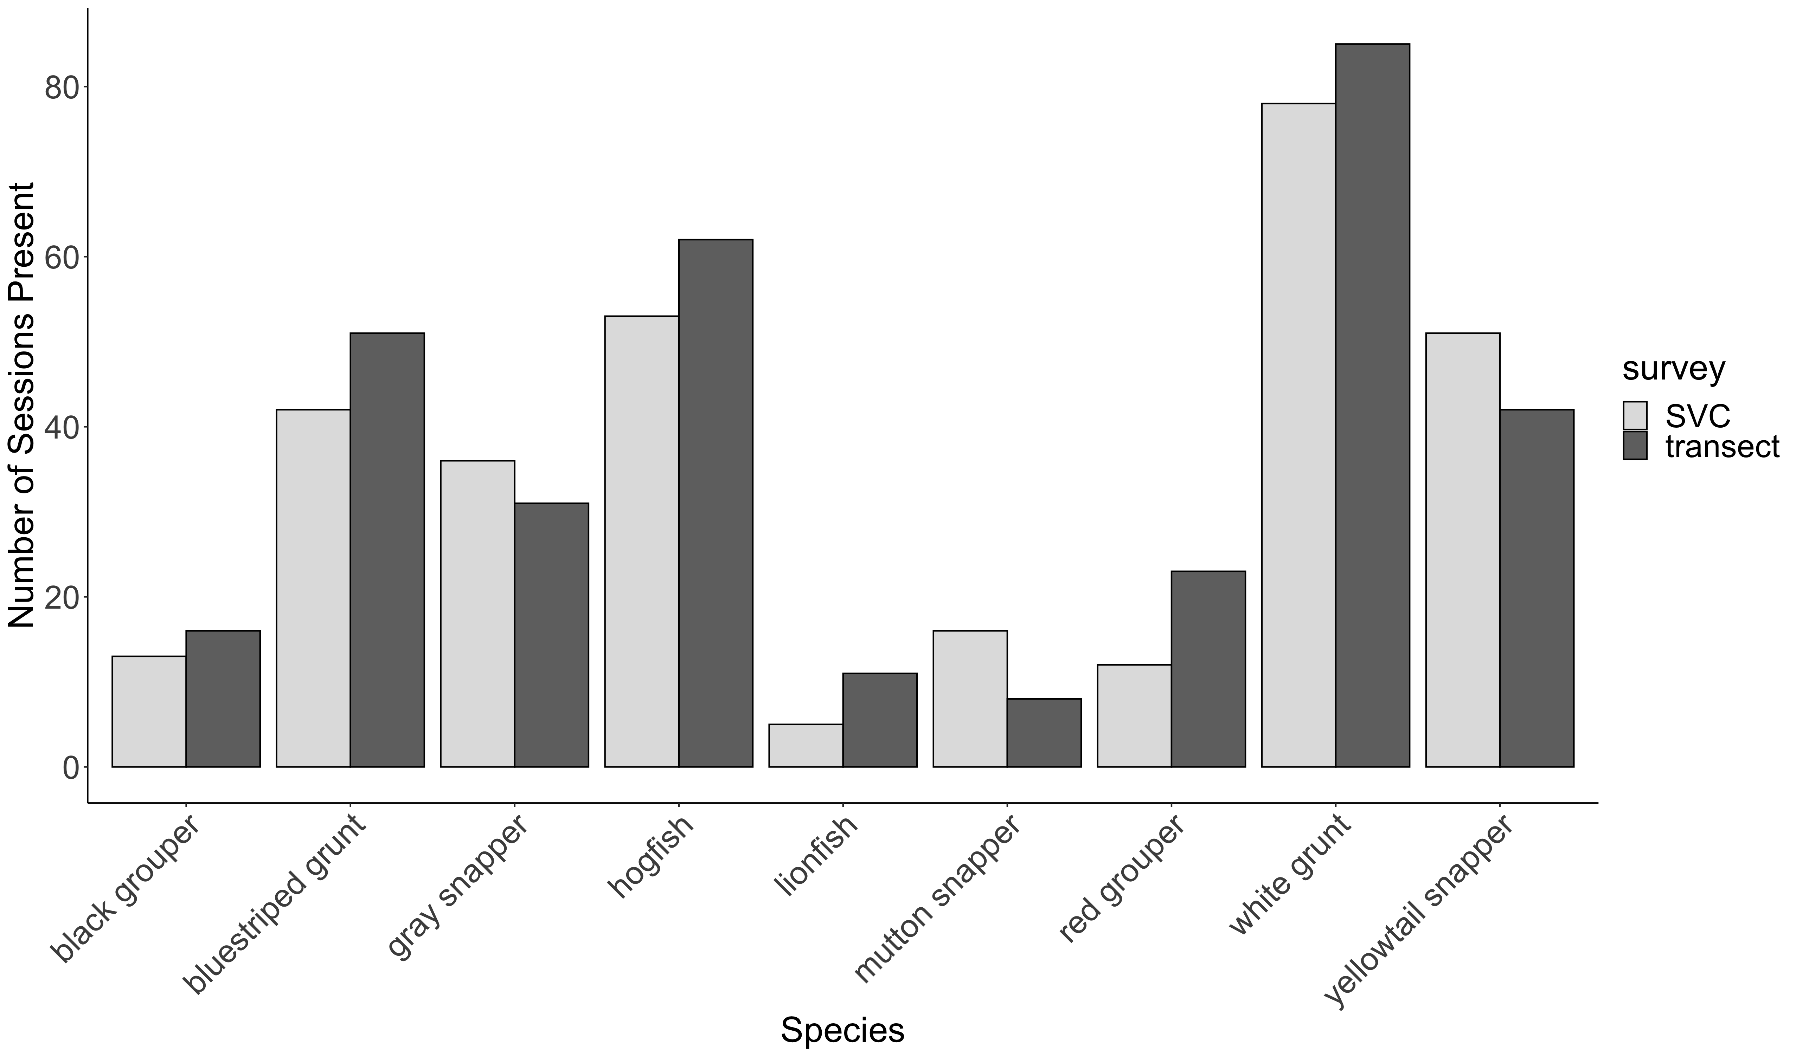
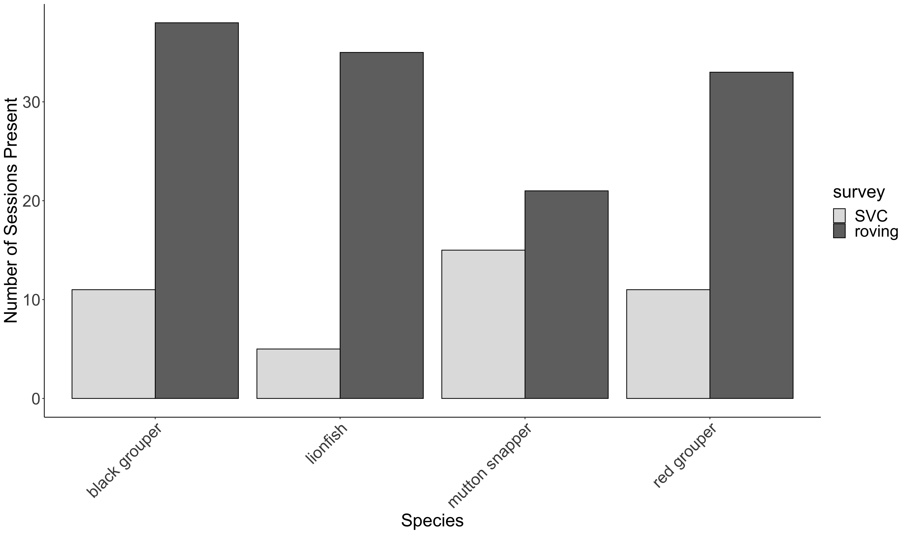
A.
C.
**
***
**
**
***
B.
D.
***
***
***

